Slide 1
IE 563 Experimental Design in Engineering
Dr. Erin Gerber, P.E.
Department of Industrial Engineering
University of Louisville

Slide 2
References
Montgomery, Design and Analysis of Experiments, 8th Edition, John Wiley & Sons, New York, 2013.
Box, Hunter, Hunter, Statistics for Experimenters: Design, Innovation, and Discovery, 2nd edition, Wiley-Interscience, 2005.
Kuehl, Design of Experiments: Statistical Principles of Research Design and Analysis, 2nd edition, Cengage Learning, 1999.
Oehlert, A First Course in Design and Analysis of Experiments, W.H. Freeman and Company, 2000.
Berger and Maurer, Experimental Design with Applications in Management, Engineering and the Sciences, Duxbury, 2001.
Based on slides by Dr. Gail DePuy

Slide 3
Minitab Software
We will be using Minitab software throughout this course.
Download free Minitab from UofL IT
Minitab can also be accessed from Citrix Receiver

Slide 4
Chapter 1 Introduction to Designed Experiments

Slide 5
What is Experimental Design?
An experiment is a test, or a series of tests, in which purposeful changes are made to the controllable input variables of a process or system so that we may observe and identify the reasons for changes in the output response.
Make purposeful changes to factors (i.e. independent or controllable input variables) to determine affect on the response (i.e. dependent variables or output).
Determine which factors significantly affect the response.
Determine how significant factors affect the response.

Slide 6
Random Experiments
An experiment that can result in different outcomes, even though it is repeated in the same manner every time, is a called a random experiment.
Controlled Variables
(factors)
System output affected by known sources of variation and random variation.
Input
(materials)
Output (response)
System
Examples: baseball hitting, car braking distance, concrete strength.
Controllable variables?
And random variation!
Noise (random) Variables

Slide 7
Why use Experimental Design?
How to learn about and control complex systems?
Mathematical/Mechanistic Model
Empirical Model: Experimentation
Examples: Car brake distance, Concrete strength
How to mathematically model the system and its variation?
Why study variation? When we incorporate variation into our thinking and analysis, we can make informed judgments that are not invalidated by the variation
How to use model to draw conclusions or make predictions?

Slide 8
Objectives of the Experiment
Determine which factors (independent variables) most affect the response (dependent variable).
Determine where to set the influential factors so the response is near a desired nominal value.
Determine where to set factors so that variation in response is minimized .

Slide 9
Some of the factors affect the location of the response variable (average or mean value).
Some affect the response dispersion (standard deviation).
Some affect both response location and dispersion.
The rest have no influence on the response variables.
One objective of the data analysis is to determine which of these factors affect the response average, which affect the standard deviation, which affect both, and which have no affect.

Slide 10
Factor A affects the average response
Distribution of responses from repeated experiments
A₁ : factor A, level (setting) 1
A₂ : factor A, level (setting) 2
A₁
A₂
response
Factor B affects the response standard deviation
B₂
B₁
response

Slide 11
Factor C affects the response average and standard deviation
C₂
C₁
response
Factor D has no effect on response average or standard deviation
D₁ = D₂
response

Slide 12
Design of Experiments (DOE)
Classical design of experiments is a formal methodology wherein purposeful changes in the factors are made with the aim to observe the resulting changes in the response variables.
Vital few factors are determined from the analysis of resulting data.
With the vital few factors identified, mathematical models for predicting the response variable and its standard deviation can be developed.
These models will be used to determine the values of the factors which will provide the best response average and the lowest possible standard deviation of the response variable(s).

Slide 13
Potential Results of Designed Experiment
Evaluation of materials, design alternatives, setting component & system tolerances, etc.
Improve performance of existing processes
Achieve product & process robustness
Improve reliability and performance of products
Reduce time to design/develop new products & processes

Slide 14
Need for Statistical Analysis Cake Baking Example
Goal: Bake a fluffy cake.
Response: Cake height (measured in inches)
Potential Factors:
# eggs
Amount of flour
Oven temperature
Shape of baking pan
Brand of flour
Type of oven

Slide 15
Cake Baking Example (cont.)
Not all factors will have a significant effect on cake height.
How to determine which factors are significant?
How to predict cake height for given factor levels?
How to choose factor levels (settings) to achieve desired cake height?

Slide 16
Cake Baking Example (cont.)
Could(?) develop and analyze equations for all chemical reactions in cake baking
OR Could perform an experiment
Simple example….
Determine if # eggs (factor) affects cake height (response).
Bake cakes at several factor levels (2 eggs, 3 eggs, 4 eggs) and compare cake heights.

Slide 17
Cake Baking Example (cont.)
Bake 5 cakes at each of the 3 factor levels.
Do you expect all cakes baked with 3 eggs to be exactly the same height? Suppose all other factors held constant.
No! Why?
RANDOM VARIATION

Slide 18
Cake Baking Example (cont.)
Does # eggs affect cake height?
Does it matter whether I use 2, 3 or 4 eggs?
Experiment 1
Experiment 2
Is a 0.74” difference in average cake height enough to conclude #eggs does affect cake height?

Slide 19
Cake Baking Example (cont.)
In both experiments the average cake heights were the same.
However the spread or variance of the cake height is larger in experiment 2 (i.e. more random variation).
Our conclusion (does # eggs affect cake height?) depends on both
Comparison of average responses at each factor level
Comparison of variance between avg. level responses to random variation (variance of responses within each factor level)

Slide 20
Cake Baking Example (cont.)
If the variance between avg. level responses is much larger than the random variation, then factor significantly affects response.
How large is ‘much larger’?
Do statistical test called Analysis of Variance (ANOVA).
Once significant factors identified, predictive model can be built

Slide 21
Cake Baking Example (cont.)
Use Regression Analysis to build a predictive model.
Cake ht = 1.7 + 0.4*(# eggs)
Note: This was a simple example (only one factor; # eggs). Your experiment could have many factors.
Cake ht = 0.3 + 0.1*(# eggs)+0.2*(cups of flour) – 0.05*(oven temp)

Slide 22
3 Basic Principles of DOE
Replication – repeating entire experiment
Cake baking experiment had 5 replicates
2 important properties of replication
Estimation of random error
Precision of estimates
Randomization – both allocation of experimental material and order in which experimental runs are conducted should be randomized
Average out uncontrolled factors
Blocking – increase precision of random error estimate by eliminating known source of variation

Slide 23
DOE Steps
Problem statement
Choose response(s)
Choose factors and levels
Perform experiment
Data analysis
Conclusions and recommendations

Slide 24
Step 1. Problem Statement
Clearly define goals of experiment
Involve many departments
Engineering
Management
Marketing
Manufacturing
Quality Control
Customer service

Slide 25
Step 2: Choose Response
Response must be measurable
Response must be measured on continuous scale to use Linear Regression
No binary responses (yes/no, go/no go, etc.)
No categorical responses (small/medium/large, 5 point scales, etc.)
Can use Logistic Regression for non-continuous responses

Slide 26
Step 3: Choose Factors and Levels
Requires process knowledge.
Mathematically no limit on number of factors, HOWEVER smaller number of factors will keep experiment simple and aid interpretation of results.
Must have a finite number of factor levels for ANOVA.
Can have an ‘infinite’ number of factor levels for regression analysis.
Many experiments use 2 levels of each factor
Simplifies data collection
Simplifies analysis

Slide 27
Step 4: Perform Experiment
Choose number of replicates (number of repeated observations at same combination of factor levels) to obtain a desired degree of confidence.
More replicates = more confidence
More replicates = more time = more $
DOE software packages or Taguchi methods can be used to choose sample size

Slide 28
Step 4: Perform Experiment (cont.)
Use randomized run order to ensure independent observations and to ‘average out’ uncontrolled variables
Learning curve
Fatigue
Machine wear
Be careful – sloppy execution can significantly affect results

Slide 29
Step 5: Data Analysis
ANOVA
ANOVA Table
Main effects and interaction plots
Residual analysis – check ANOVA assumptions
Regression analysis
Regression equation
R² value – evaluate model fit
Residual analysis
Use statistical software
Minitab - Design Ease
SAS - R
SPSS

Slide 30
Step 6: Conclusions and Recommendations
Try to keep models simple to aid interpretation
Experimentation should be iterative
major mistake to develop one large experiment
generally expend only 25% of resources on the 1st set of experiments

Slide 31
Step 6: Conclusions and Recommendations (cont.)
Statistical vs practical significance
Just because a factor is statistically significant does not necessarily mean it has practical value
e.g. Cake baking experiment
Factor: brand of flour
2 Levels: cheap ($1/cup), expensive ($4/cup)
Expensive flour found to produce cakes, on average, 0.2” taller than cheap flour
0.2” may be a statistically significant difference, but 0.2” not of practical consequence given dramatic cost difference

Slide 32
Four Eras in the History of DOE
The agricultural origins, 1918 – 1940s
R. A. Fisher & his co-workers
Profound impact on agricultural science
Factorial designs, ANOVA
The first industrial era, 1951 – late 1970s
Box & Wilson, response surfaces
Applications in the chemical & process industries
The second industrial era, late 1970s – 1990
Quality improvement initiatives in many companies
Taguchi and robust parameter design, process robustness
The modern era, beginning circa 1990

Slide 33
Chapter 2 Statistics Review

Slide 34
Statistic Review
Numerical Summaries of Data
Descriptive Statistics
Mean, Variance, Median
Graphical presentation of data
Histogram, Probability Plot
Sampling Distributions
Simple experiments
Confidence Intervals
Hypothesis Testing

Slide 35
Statistics
The field of statistics deals with the collection, presentation, analysis, and use of data to:
Make decisions
Solve problems
Design products and processes
Statistical techniques are useful for describing and understanding variability.
Statistics gives us a framework for describing this variability and for learning about potential sources of variability.
Known source of variation
Random variation

Slide 36
Numerical Summaries of Data
Conduct experimentation and collect data
How to characterize data so we can use it to draw conclusions and make decisions?
In most analyses, we work with a sample of observations selected from a population we wish to study
Population – the entire collection of objects or outcomes about which information is sought
Sample – subset of the population measured by the experimenter
Suppose we are interested in numerically describing the length of adult feet (to make socks)
Population = all adults in the world? All adults in USA?
Sample 1 = all students at UofL
Sample 2 = all students in this class

Slide 37
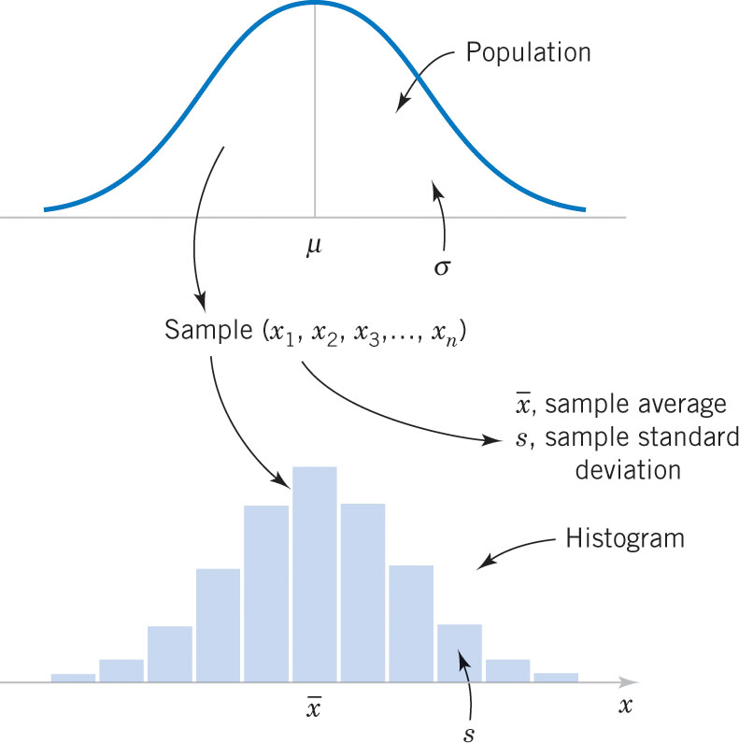
Numerical Summaries of Data
Figure Relationship between a population and a sample.

Slide 38
Descriptive Statistics
A statistic is a function of the observations in a random sample.
Some common statistics
Suppose the sample has n observations denoted x₁, x₂, …, x_{n}
Sample Mean
Sample Variance
Sample Standard Deviation
Note: Mean can be negative, but s² and s cannot be negative

Slide 39
Descriptive Statistics
A parameter is a function of the observations in a population.
Some common parameters
Suppose the population has N observations denoted x₁, x₂, …, x_{N}
Population Mean
Population Variance
Population Standard Deviation
Analogous to mean, variance, and standard deviation of probability distribution

Slide 40
Descriptive Statistics
The sample variance is calculated with the quantity n-1 called the “degrees of freedom”.
Origin of the term:
There are n deviations from x-bar in the sample.
The sum of the deviations is zero. (Balance point)
n-1 of the observations can be freely determined, but the n^{th} observation is fixed to maintain the zero sum.
The true population variance is based on data deviations from the true population mean, μ.
The sample variance is based on the data deviations from x-bar, not μ. X-bar is an estimator of μ; close but not the same. So the n-1 divisor is used to compensate for the error in using x-bar to estimate μ.

Slide 41
Descriptive Statistics
Sample Variance is Sum of Squares divided by degrees of freedom (df), often called Mean Square
So, a mean square is a measure of dispersion or variance

Slide 42
Descriptive Statistics
Use Mean and Variance to summarize probability distribution of rv
Mean is measure of center of distribution
Mean = balance point of loading
Variance is measure of spread or dispersion of distribution
The sample mean as a balance point
8 Observations:
12.6 12.9 13.4 12.3 13.6 13.5 12.6 13.1
12 13 14

Slide 43
Descriptive Statistics
Sample variance measures variability through deviations
12 13 14

Slide 44
Descriptive Statistics
The median is a measure of central tendency that divides the data into two equal parts, half below the median and half above.
Sort data from smallest to largest observation
If n is odd, then the median is the rounddown(n/2) +1 observation
If n is even, then the median is halfway between the n/2 and (n/2)+1 observations.
12.3 12.6 12.6 12.9 13.1 13.4 13.4 13.6
Median = 13.0 cm

Slide 45
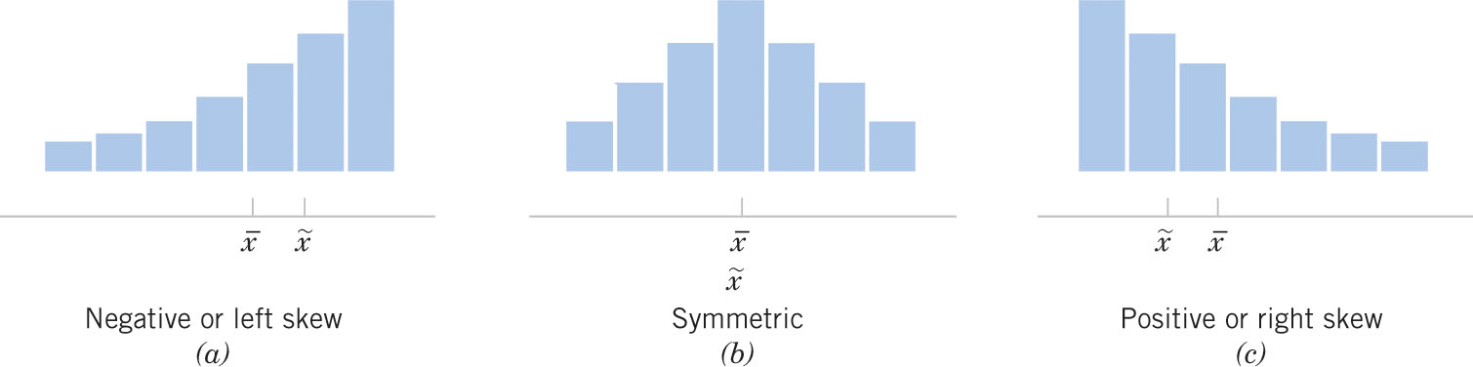
Descriptive Statistics
Relationship between mean and median helps determine if distribution is symmetric or skewed
Figure 6-11 Histograms for symmetric and skewed distributions.

Slide 46
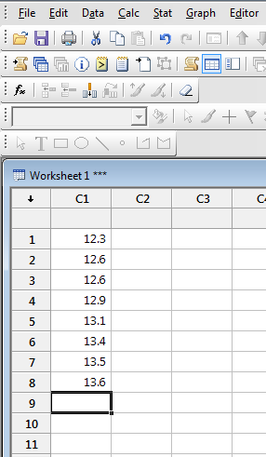
Descriptive Statistics in Minitab
Enter data in single column

Slide 47
Descriptive Statistics in Minitab
Stat
Basic Statistics
Display Descriptive Statistics
Enter Column
Choose Statistics

Slide 48
Descriptive Statistics in Minitab
Descriptive Statistics: C1
Total
Variable Count Mean StDev Median Range
C1 8 13.000 0.478 13.000 1.300

Slide 49
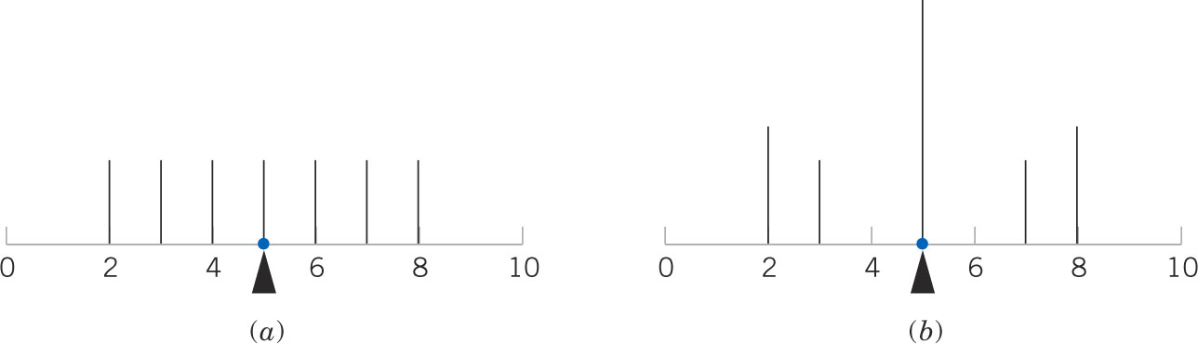
Descriptive Statistics
Mean and variance DO NOT uniquely describe a distribution.
Different distributions can have the same mean and variance
However they are simple, useful summaries of the probability distribution

Slide 50
Histograms
A frequency distribution or histogram helps us visualize the general shape of the distribution
To construct a frequency distribution, divide the range of the data into intervals of equal width, which are usually called class intervals, cells, or bins. Above each bin, draw a rectangle whose height is equal to the frequency or relative frequency.

Slide 51
Histograms in Minitab
Enter data in single column
Graph
Histogram
Simple
Enter column

Slide 52
Histograms in Minitab

Slide 53
Probability Plots
How do we know what distribution is a good fit to our data?
Normal? Uniform? Exponential?
Probability plotting is a graphical method for determining whether sample data conform to a hypothesized distribution based on a subjective visual examination of the data.
In the past, probability plotting used special graph paper that has been designed for the hypothesized distribution.
Vertical axis scaled for distribution such that plotted data will appear as a straight line if data well fit by distribution
We’ll use Minitab

Slide 54
Probability Plots in Minitab
Enter data in single column
Graph
Probability Plot (NOT Probability Distribution Plot)
Enter column
Choose distribution
(default: Normal Distr)

Slide 55
Probability Plots in Minitab
Straight fitted distribution line (middle blue line) a good fit?
High P-Value (close to 1) and Low AD Stat (close to 0) indicate good fit
P-value is probability this distribution is a good fit

Slide 56
Probability Plots in Minitab
Straight fitted distribution line good fit?
Low P-Value and High AD Stat indicate bad fit

Slide 57
Foot Length Sample
Back to our sock problem……
Interested in length of adult feet
Measured foot length (in cm) of 28 students in Prob & Stat course (i.e. sample size = n = 28)
25.38 | 29.38 | 27.95 | 27.34 | 25.51 | 25.25 | 28.25
24.95 | 24.43 | 23.66 | 23.04 | 27.69 | 24.64 | 25.30
26.90 | 25.45 | 26.51 | 29.49 | 26.17 | 26.61 | 29.59
24.75 | 26.77 | 25.03 | 26.45 | 27.16 | 28.96 | 24.41

Slide 58
Foot Length Sample
Descriptive Statistics: foot length
Variable Mean StDev Minimum Median Maximum
foot length 26.322 1.786 23.040 26.310 29.590

Slide 59
Foot Length Sample

Slide 60
How to use Sample
Statistical inference is concerned with making decisions about a population based on the information contained in a random sample from that population
However there could be lots of different samples
Foot length example
How to generalize the info from our sample to make decision about population?
Parameter: property of unknown probability distribution or population
Mean, μ, or variance, σ²
Statistic: property of a sample. A statistic is any function of the observations in a random sample.
Sample mean, x, or sample variance, s²
Statistics are known. We use statistics to estimate unknown parameters

Slide 61
Statistical Inference
Example: Suppose we are interested in the average length of an adult’s foot
Measure everyone’s foot? Calculate μ? ☹
Take random sample of 28 people
Calculate sample mean, x = 26.32 cm
Estimate the population average foot length. Estimate μ.
x is a point estimate for μ.
HOWEVER, different samples will have different x

Slide 62
Sampling Distributions
Foot length example
Go to 100 different UofL classes and measure feet of 28 students (i.e. 100 samples, each of size 28)

Slide 63
Sampling Distributions
Foot length example
100 samples, each n=28
Calculate sample mean, x, and sample variance, s², for each sample

Slide 64
Sampling Distributions
Foot length example
Distribution of sample means and sample variances
x ~ Normal distr
x ~ Student t distr
s² ~ Chi-squared distr

Slide 65
Sampling Distributions
Sampling distribution for sample mean when large sample (n≥40) → Normal distribution
Sampling distribution for sample mean when small sample (n<40) → Student-t distribution
Sampling distribution for sample variance → Chi-squared distribution
Sampling distribution of the ratio of two sample variances → F Distribution
How to use sample statistic and sampling distribution to make inference about population parameter?
Confidence Intervals
Hypothesis Testing

Slide 66
Confidence Intervals
How to estimate a population parameter using sample statistics?
Estimate mean length of adult foot. Measure 28 students and find X = 26.322 cm. Is this a good estimate for μ?
Do we believe μ EXACTLY equals 26.322 cm (μ=X)?
What if we measure the foot lengths of a different sample of 28 students?
Rather than estimate μ with a single value (called point estimate) let’s develop range or interval of values (called interval estimate) we think contains true value of μ.
Now rather than saying μ = 26.322 cm, we say 25.77 ≤ μ ≤ 26.87 cm

Slide 67
Confidence Intervals
A confidence interval for an unknown population parameter θ (e.g. μ, σ²) is an interval that contains a set of plausible or believable values of the parameter.
Confidence interval: lower limit ≤ θ ≤ upper limit (L ≤ θ ≤ U)
Example CI on population mean μ: 25.77 ≤ μ ≤ 26.87 cm
Definition of 100(1-α)% CI on θ: P(L ≤ θ ≤ U) = 1-α
How likely the CI is to contain the unknown population parameter θ is determined by the confidence level, 1-α
confidence level is 1-α
where 0 ≤ α ≤ 1

Slide 68
Confidence Intervals
Common 100(1-α)% CI:
99% CI: P(L ≤ θ ≤ U) = 0.99 → 1-α = 0.99 → α = 0.01
95% CI: P(L ≤ θ ≤ U) = 0.95 → 1-α = 0.95 → α = 0.05
90% CI: P(L ≤ θ ≤ U) = 0.90 → 1-α = 0.90 → α = 0.10
Why not use 100% CI? Or 99.9999% CI ?
The width of a CI is a measure of the precision of estimation.
The wider the CI, the more confident we are that the interval actually contains the true value of θ.
as confidence level (i.e. 1-α) ↑, CI width ↑
However, the wider the CI the less information we have about the true value of θ
Ideal situation: a relatively narrow interval with high confidence.
This is possible when sample size is large and/or variance is small.

Slide 69
Confidence Intervals
We take one sample and calculate CI. How do we know if our CI really contains θ?
We do NOT know. But we know likelihood it does (i.e. 1-α)
How to calculate upper and lower CI limits?
Take sample and calculate sample statistics
Using the sampling distribution of the appropriate sample statistic, choose 100(1-α)% CI such that P(L ≤ θ ≤ U) = 1-α
Choose L and U such that the 100(1-α)% CI for all sample mean in this range will contain μ i.e. P(L ≤ μ ≤ U) = 1-α
e.g. Sampling distribution for sample mean when large sample (n≥40) is Normal distribution

Slide 70
CI on the Mean, μ, for Large Sample
100(1-α)% Confidence Interval on μ
where Z_{α/2} is the upper 100(α/2) percentage point of N(0,1)
CI centered around sample mean, X
CI width (upper limit – lower limit) is a function of:
Confidence level, 1-α
As confidence level ↑, CI width ↑
Sample size (i.e. # observations)
As sample size↑, CI width ↓
Variance of data (as measured by S²)
As variance ↑, CI width ↑
Lower limit
Upper limit

Slide 71
Simple Experiments: CI
Single population
CI on mean, µ, large sample (n≥40)
100(1-α)% two-sided CI
100(1-α)% upper-confidence bound
100(1-α)% lower-confidence bound
Believable µ=µ₀?
Yes, if µ₀ contained in CI
Be careful interpreting one-sided CI
Statement is believable if ALL values in CI satisfy statement
If CI completely contained in statement, then statement is believable
where Z_{α/2} is the upper 100(α/2) percentage point of N(0,1)

Slide 72
Simple Experiments: CI
Single population
CI on mean, µ, small sample (n<40)
100(1-α)% two-sided CI
100(1-α)% upper-confidence bound
100(1-α)% lower-confidence bound
Remember: Student t Distribution is sampling distribution of the sample mean, when sample size is small (n<40) and underlying distribution is Normal (or close to Normal)

Slide 73
Simple Experiments: CI
Single population
CI on variance, σ²
100(1-α)% two-sided CI
100(1-α)% upper-confidence bound
100(1-α)% lower-confidence bound
Believable σ²=σ₀²?
Yes, if σ₀² contained in CI
Remember: Chi squared Distribution is sampling distribution of the sample variance, when underlying distribution is Normal (or close to Normal)

Slide 74
Simple Experiments: CI
Two populations
CI on means, comparing µ₁ and µ₂, large sample (n≥40)
100(1-α)% two-sided CI
100(1-α)% upper-confidence bound
100(1-α)% lower-confidence bound
Believable µ₁=µ₂? Yes, if 0 contained in CI
where Z_{α/2} is the upper 100(α/2) percentage point of N(0,1)

Slide 75
Simple Experiments: CI
Two populations
CI on means, comparing µ₁ and µ₂, small sample (n < 40) AND population variances assumed to be equal (i.e. σ²₁ = σ²₂ )
100(1-α)% two-sided CI
100(1-α)% upper-confidence bound
100(1-α)% lower-confidence bound

Slide 76
Simple Experiments: CI
Two populations
Test on means, comparing µ₁ and µ₂, small sample (n<40) AND population variances assumed to be unequal (i.e. σ²₁ ≠ σ²₂ )
100(1-α)% two-sided CI
100(1-α)% upper-confidence bound
100(1-α)% lower-confidence bound

Slide 77
Simple Experiments: CI
Two populations
Test on variances, comparing σ₁² and σ₂²
100(1-α)% two-sided CI
100(1-α)% upper-confidence bound
100(1-α)% lower-confidence bound
Believable σ₁²=σ₂²? Yes, if 1 contained in CI
Remember: F Distribution is sampling distribution of the ratio of two sample variance, when underlying distributions are Normal (or close to Normal)
Note: F _{1-α,u,v} = 1/ F _{α,v,u}

Slide 78
Simple Experiments: CI
How to know which CI to use?
Single population or two populations?
What is parameter of interest? µ or σ²?
If interested in mean, µ, of single population, is sample large? Or is sample small?
If interested in comparing means, µ₁ vs µ₂, of two populations with unknown variances (i.e. small samples), are population variances assumed to be the same (i.e. σ²₁ = σ²₂ )? Or different (i.e. σ²₁ ≠ σ²₂ )?
One-sided or Two-sided test?
Be careful interpreting one-sided CI
Statement is believable if ALL values in CI satisfy statement
If CI completely contained in statement, then statement is believable

Slide 79
Simple Experiments: CI
A textile manufacturer wants to find a 95% confidence interval on the mean breaking strength of a fiber.
The manufacturer collects a sample of 50 fibers and finds the sample mean to be 215 psi and the sample standard deviation to be 100 psi.
α = 0.05 Xbar = 215 S = 100 n = 50
95% CI on µ
Believable that µ = 200psi? µ =150 psi?
From N(0,1) table, Z_{0.025} = 1.96

Slide 80
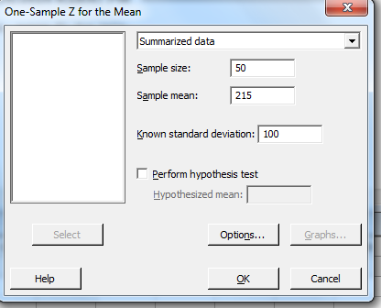
Simple Experiments: CI
Confidence Intervals in Minitab
Enter data in column(s) or can enter summarized data
For our previous example….
>Stat
>Basic Statistics
>1-sample Z
Default is 95% two-sided CI
‘Options’ to change confidence level and one-sided CI

Slide 81
Simple Experiments: CI
One-Sample Z
The assumed standard deviation = 100
N Mean SE Mean 95% CI
50 215.0 14.1 (187.3, 242.7)
Believable that µ = 200psi? µ =150 psi?

Slide 82
CI and Hypothesis Testing
Both CI and Hypothesis testing are used to make a statistical inference
Use sample statistic to ‘guess’ population parameter
In CI we formed an interval around sample statistic and used the interval to answer questions
Believable that μ=12? Believable that σ<3.2?
In hypothesis testing we are making a statement about the population parameter then using the sample statistic to decide whether the statement is believable or not

Slide 83
Hypothesis Testing
Now we’ll learn how to accept or reject a statement or hypothesis about an unknown population parameter (μ, σ²)
Make statement, called Null Hypothesis, H₀, about population parameter,θ
Examples: H₀: μ = 27.0 H₀: σ ≤ 3.27
Actually make 2 contradictory statements about population parameter,θ
Null Hypothesis, H₀ versus Alternative Hypothesis, H₁
Two-sided test: H₀: θ = θ₀ versus H₁: θ ≠ θ₀
One-sided tests: H₀: θ ≤ θ₀ versus H₁: θ > θ₀
H₀: θ ≥ θ₀ versus H₁: θ < θ₀
A Statistical Hypothesis is a statement about a population parameter

Slide 84
Hypothesis Testing
Then use sample statistic (e.g. X, S²) to decide if H₀ is believable
Example: H₀: μ = 27.0 cm
H₁: μ ≠ 27.0 cm
If sample mean, X = 26.8 cm, I would believe H₀: μ = 27.0 cm
If sample mean, X = 21.0 cm, I would NOT believe H₀: μ = 27.0 cm
I would believe H₁: μ ≠ 27.0 cm
Assume null hypothesis, H₀, is true unless sample provides overwhelming evidence H₀ is not true
Make statement, H₀, about unknown population mean, μ
Use sample mean to decide if statement, H₀, is believable

Slide 85
Hypothesis Testing
How close does sample mean, X, need to be to 27.0 cm for me to believe H₀: μ = 27.0 cm?
How far away from 27 cm does the sample mean, X, need to be for me to believe H₁: μ ≠ 27.0 cm?
How to decide to accept or reject H₀ based on sample?
Always in terms of accepting/rejecting H₀ , NOT H₁
When we accept H₀ we are saying H₀ is plausible or believable. However accepting H₀ does not prove H₀ to be true.
Depends on:
Variance, σ²
Sample size, n
Significance level, α
Same factors that determine CI width

Slide 86
Hypothesis Testing
We either Accept or Reject H₀ based on our sample statistic
Our decision to accept or reject H₀ will either be right or wrong.
We’ll never know for certain whether we’re right or wrong (because we do not know population parameter), but we can find the probability we’re wrong
Two ways we could be wrong:
Reject H₀ when H₀ is true (type I error)
Accept H₀ when H₀ is false (type II error)

Slide 87
Hypothesis Testing
 | H₀ True | H₀ False
Accept H₀ | correct | Type II error
Reject H₀ | Type I error | correct
Probability of Type I error = α Reject H₀ when H₀ is true
Probability of Type II error = β Accept H₀ when H₀ is false
Power, 1-β, is the probability of correctly rejecting a false null hypothesis.
We often compare statistical tests by comparing their power
α called significance level
1-β called power of the hypothesis test

Slide 88
Hypothesis Testing
How to decide to accept or reject H₀? How to choose critical values?
State H₀ and H₁
Choose significance level, α
Take sample and calculate sample statistics
Use the sampling distribution of the appropriate sample statistic to determine critical values and therefore whether to accept or reject H₀
e.g. Use Normal distribution to find critical values for population mean, μ, when n≥40
The 100(1-α)% sample means closest to μ₀ are acceptance region
where Z_{α/2} is the upper 100(α/2) percentage point of N(0,1)

Slide 89
Hypothesis Testing
Choose critical values based on specified probability of type 1 error, α
Common values of α
α = 0.05
α = 0.01
α = 0.10
Why not choose α=0?
i.e. no type I error
As α gets smaller, acceptance region gets bigger
All sample mean will support H₀: μ = μ₀
No meaningful info about μ
1-α
Reject H₀
Reject H₀
Accept H₀
μ₀
Critical values

Slide 90
Hypothesis Testing
The “strongest” inference is available when the null hypothesis is rejected.
Sample provides overwhelming evidence H₀ is not believable
This point is important when an experimenter decides what should be the null hypothesis and what should be the alternative hypothesis for one-sided problems.
In order to “prove” or establish a statement (say μ > μ₀) it is necessary to make it the alternative hypothesis (H₁).
For one-sided hypothesis test, make H₁ the statement you are evaluating

Slide 91
Simple Experiments: Hypothesis Testing
Single population
Test on mean, µ, large sample (n≥40)
Null hypothesis: H₀: μ=μ₀
Test Alternative
Statistic Hypothesis H₀ Rejection Criteria
H₁: μ ≠ μ₀ |Z₀| > Z _{α/2}
H₁: μ > μ₀ Z₀ > Z _{α}
H₁: μ < μ₀ Z₀ < −Z _{α}

Slide 92
Simple Experiments: Hypothesis Testing
Single population
Test on mean, µ, small sample (n<40)
Null hypothesis: H₀: μ=μ₀
Test Alternative
Statistic Hypothesis H₀ Rejection Criteria
H₁: μ ≠ μ₀ |T₀| > t _{α/2,n-1}
H₁: μ > μ₀ T₀ > t _{α,n-1}
H₁: μ < μ₀ T₀ < −t _{α, n-1}

Slide 93
Simple Experiments: Hypothesis Testing
Single population
Test on variance, σ²
Null hypothesis: H₀: σ² = σ₀²
Test Alternative
Statistic Hypothesis H₀ Rejection Criteria
H₁: σ² ≠ σ₀² X₀² > X²_{α/2,n-1} or X₀² < X²_{1-(α/2),n-1}
H₁: σ² > σ₀² X₀² > X²_{α,n-1}
H₁: σ² < σ₀² X₀² < X²_{1-α,n-1}

Slide 94
Simple Experiments: Hypothesis Testing
Two populations
Test on means, µ₁ and µ₂, large sample (n≥40)
Null hypothesis: H₀: μ₁=μ₂
Test Alternative
Statistic Hypothesis H₀ Rejection Criteria
H₁: μ₁ ≠ μ₂ |Z₀| > Z _{α/2}
H₁: μ₁ > μ₂ Z₀ > Z _{α}
H₁: μ₁ < μ₂ Z₀ < −Z _{α}

Slide 95
Simple Experiments: Hypothesis Testing
Two populations
Test on means, µ₁ and µ₂, small sample (n < 40) AND population variances assumed to be equal (i.e. σ²₁ = σ²₂ )
Null hypothesis: H₀: μ₁=μ₂
Test Alternative
Statistic Hypothesis H₀ Rejection Criteria
H₁: μ₁ ≠ μ₂ |t₀| > t _{α/2,n1+n2-2}
H₁: μ₁ > μ₂ t₀ > t _{α,n1+n2-2}
H₁: μ₁ < μ₂ t₀ < -t _{α,n1+n2-2}
where

Slide 96
Simple Experiments: Hypothesis Testing
Two populations
Test on means, µ₁ and µ₂, small sample (n < 40) AND population variances assumed to be unequal (i.e. σ²₁ ≠ σ²₂ )
Null hypothesis: H₀: μ₁=μ₂
Test Alternative
Statistic Hypothesis H₀ Rejection Criteria
H₁: μ₁ ≠ μ₂ |t₀| > t _{α/2,v}
H₁: μ₁ > μ₂ t₀ > t _{α,v}
H₁: μ₁ < μ₂ t₀ < -t _{α,v}
where

Slide 97
Simple Experiments: Hypothesis Testing
Two populations
Test on variances, comparing σ₁² and σ₂²
Null hypothesis: H₀: σ₁² = σ₂²
Test Alternative
Statistic Hypothesis H₀ Rejection Criteria
H₁: σ₁² ≠ σ₂² F₀ > F _{α/2, n1-1,n2-1} OR F₀ < F _{1-(α/2), n1-1,n2-1}
H₁: σ₁² > σ₂² F₀ > F _{α,n1-1,n2-1}
H₁: σ₁² < σ₂² F₀ < F _{1-α,n1-1,n2-1}

Slide 98
Simple Experiments: Hypothesis Testing
How to know which test statistic to use?
Single population or two populations?
What is parameter of interest? µ or σ²?
If interested in mean, µ, of single population, is sample large? Or is sample small?
If interested in comparing means, µ₁ vs µ₂, of two populations with unknown variances (i.e. small samples), are population variances assumed to be the same (i.e. σ²₁ = σ²₂ )? Or different (i.e. σ²₁ ≠ σ²₂ )?
One-sided or Two-sided test?

Slide 99
Simple Experiments: Hypothesis Testing
Example
Two catalysts are being analyzed to determine how they affect the mean yield of a chemical process.
Specifically, catalyst 1 is currently in use, but catalyst 2 is acceptable. Since catalyst 2 is cheaper, it should be adopted, providing it does not change the process yield.
A test is run using each catalyst and the results follow. Is there any difference between the mean yields of catalysts 1 and 2?

Slide 100
Simple Experiments: Hypothesis Testing
H₀: µ₁=µ₂
H₁: µ₁≠µ₂

Slide 101
Simple Experiments: Hypothesis Testing
Which test statistic to use?
Comparing 2 populations
Test on means
Small samples → variance unknown
Variances assumed to be equal? or unequal?
Can do hypothesis test to first determine whether variances equal. Then choose proper test statistic to compare means.
t test statistic

Slide 102
Simple Experiments: Hypothesis Testing
First determine if population variances equal or unequal.
H₀: σ²₁ = σ²₂
H₁: σ²₁ ≠ σ²₂
F₀ = 2.39²/2.98² = 0.6432
Critical region values for α = 0.05:
F_{0.025,7,7} = 4.99
F_{0.975,7,7} = 0.20
Since F₀ = 0.6432 < 4.99 AND F₀ = 0.6432 > 0.20 we DO NOT reject H_{0.} We believe the variances are equal.
Note: F _{1-α,u,v} = 1/ F _{α,v,u}

Slide 103
Simple Experiments: Hypothesis Testing
Now we know which t test statistic to use to test the means
H₀: µ₁ = µ₂
H₁: µ₁ ≠ µ₂
Critical region values for α=0.05
t _{0.025,14} = 2.145
Since |-0.35|<2.145 we DO NOT reject H₀. We believe the mean yields are the same for catalysts 1 and 2.

Slide 104
Simple Experiments: Hypothesis Testing
Hypothesis Testing in Minitab
Stat
Basic Statistics
Do catalyst example in Minitab
Enter data in 2 columns
First do F test to determine if variances are equal
Then do t test to compare means

Slide 105
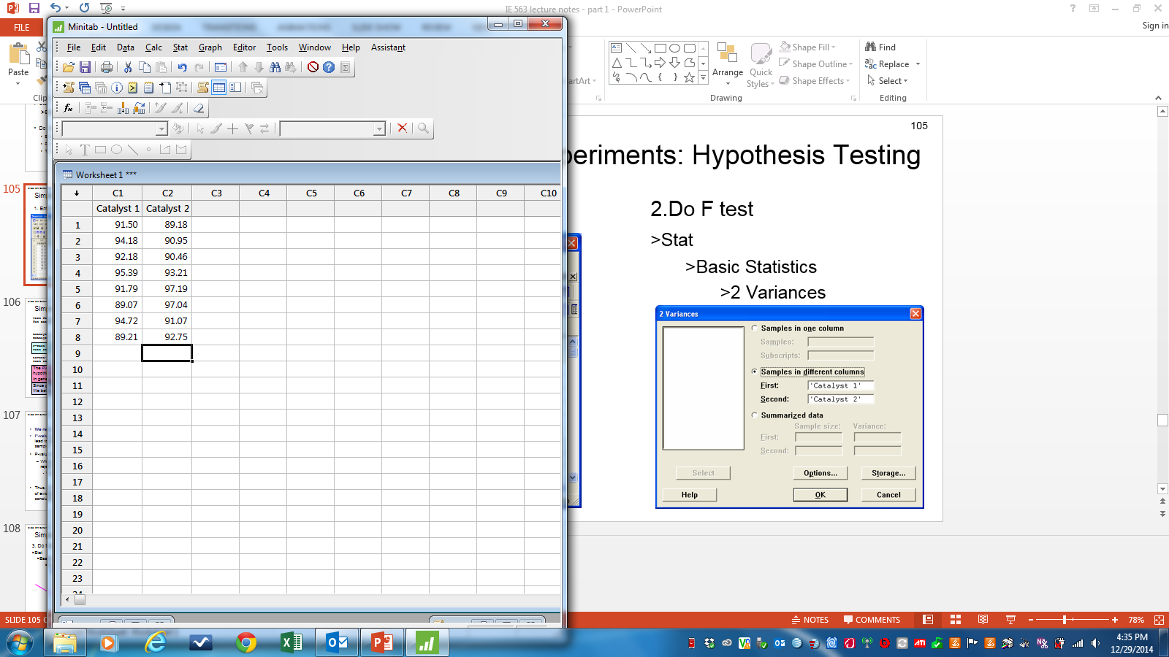
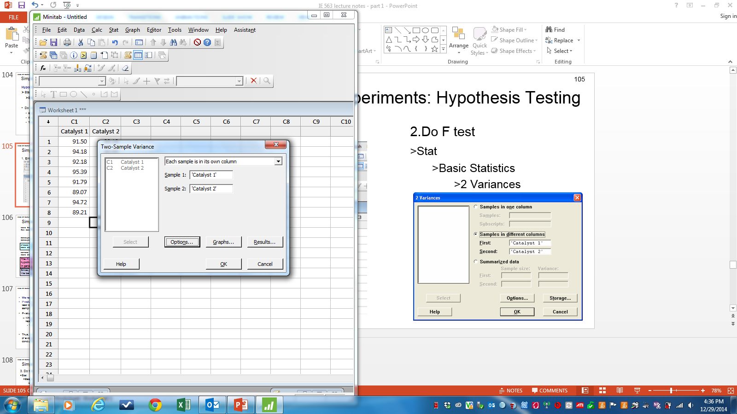
Simple Experiments: Hypothesis Testing
1. Enter Data 2.Do F test
>Stat
>Basic Statistics
>2 Variances

Slide 106
Simple Experiments: Hypothesis Testing
Test and CI for Two Variances: Catalyst 1, Catalyst 2
Method
Null hypothesis σ(Catalyst 1) / σ(Catalyst 2) = 1
Alternative hypothesis σ(Catalyst 1) / σ(Catalyst 2) ≠ 1
Significance level α = 0.05
Statistics
95% CI for
Variable N StDev Variance StDevs
Catalyst 1 8 2.386 5.691 (1.635, 4.611)
Catalyst 2 8 3.061 9.371 (1.634, 7.595)
Ratio of standard deviations = 0.779
Ratio of variances = 0.607
95% Confidence Intervals
CI for
CI for StDev Variance
Method Ratio Ratio
Bonett (0.380, 2.336) (0.145, 5.457)
Levene (0.305, 2.300) (0.093, 5.291)
Tests
Test
Method DF1 DF2 Statistic P-Value
Bonett 1 — 0.39 0.534
Levene 1 14 0.36 0.557

Slide 107
Simple Experiments: Hypothesis Testing
Ratio of Variances (F-Statistic) = 0.638
*Can compare to Rejection Criteria for F-test*
OR
P-Value = 0.565
The P-value is the risk of wrongly rejecting the null hypothesis (it measures rareness of the event).
In general, reject H₀ when p-value < α
Since p-value=0.565 > α=0.05, we DO NOT reject H₀. We believe variances are equal

Slide 108
P-value
We reject H₀ when p-value < α
P-value is the smallest level of significance (i.e. α) that would lead to rejection of the null hypothesis H₀ with the given sample.
P-value indicates how strongly we believe H₀ or H₁
When p-value very small (i.e. near 0) we STRONGLY reject H₀.
We REALLY do not believe H₀; We REALLY do believe H₁
Thus, a P-value conveys much information about the weight of evidence against H₀, and so a decision maker can draw a conclusion at any specified level of significance, α.

Slide 109
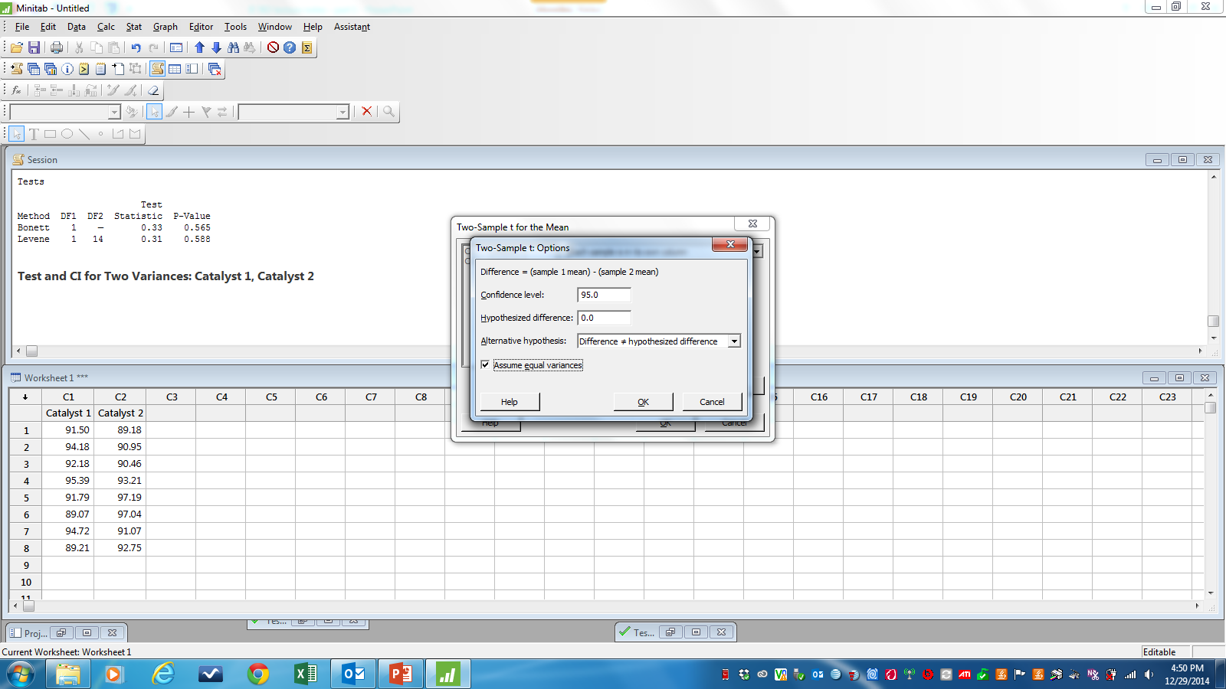
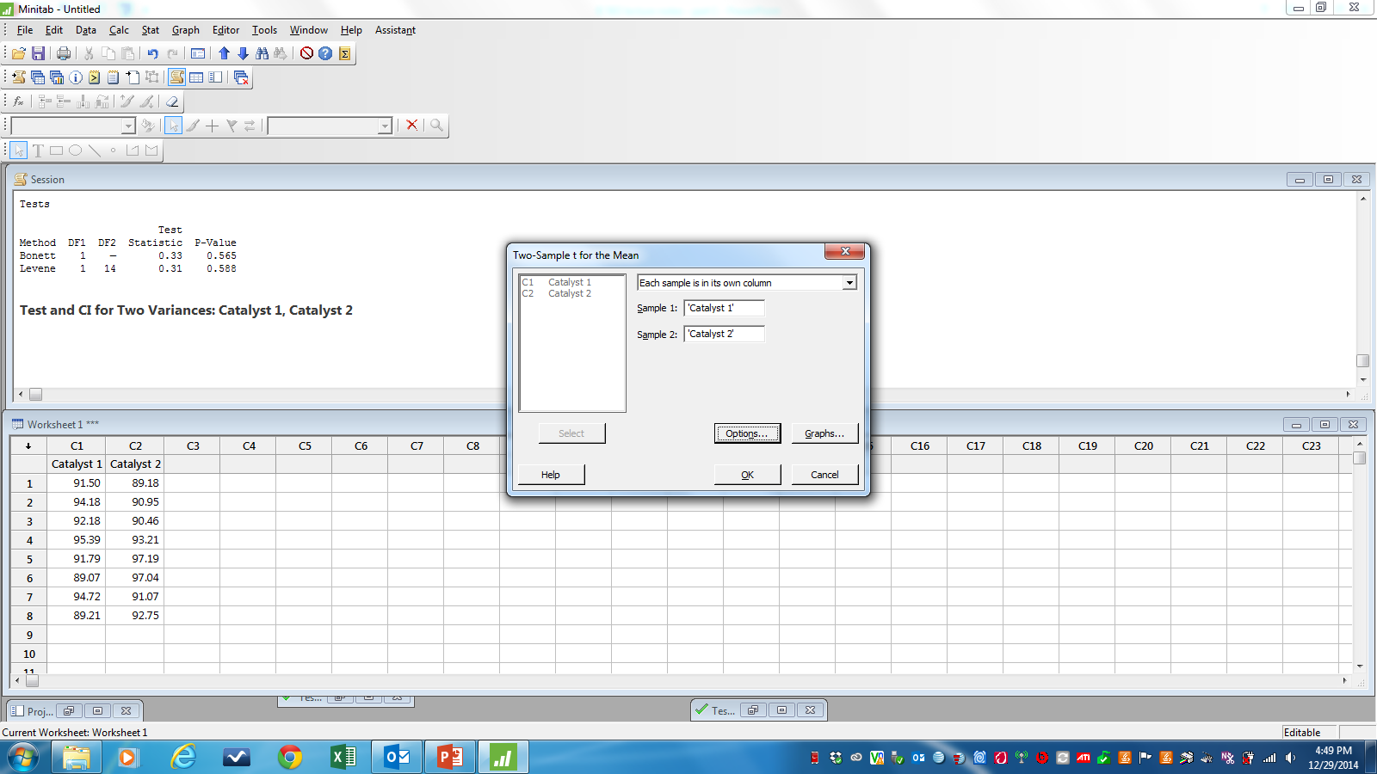
Simple Experiments: Hypothesis Testing
3. Do t test
>Stat
>Basic Statistics
>2 Sample t
*Go into Options if need to check “Assume Equal Variances”
Note: Default is two-sided test. Can change to one-sided test.

Slide 110
Simple Experiments: Hypothesis Testing
Two-Sample T-Test and CI: Catalyst 1, Catalyst 2
Two-sample T for Catalyst 1 vs Catalyst 2
N Mean StDev SE Mean
Catalyst 1 8 92.26 2.39 0.84
Catalyst 2 8 92.73 2.99 1.1
Difference = μ (Catalyst 1) - μ (Catalyst 2)
Estimate for difference: -0.48
95% CI for difference: (-3.37, 2.42)
T-Test of difference = 0 (vs ≠): T-Value = -0.35 P-Value = 0.730 DF = 14
Both use Pooled StDev = 2.7018
if p-value < α, reject H₀
Since p-value=0.730 > α=0.05, we DO NOT reject H₀. We believe means are equal

Slide 111
Simple Experiments: Hypothesis Testing
Paired t test
Detects difference between matched pairs of data.
Each pair represents a block.
Remember: the objective of blocking is to reduce error by eliminating known sources of variation due to lot-to-lot, day-to-day, operator-to-operator, machine-to-machine, etc.

Slide 112
Simple Experiments: Hypothesis Testing
Paired t test: Boys Shoe Example
We want to determine if shoe sole material A wears faster, slower, or the same as material B (measured as mm of wear after 60 days)
Data collection: Some shoes made with material A, some with material B. Ten (10) boys will wear the shoes for 60 days, after which time the wear (in mm) will be measured and analyzed.
How exactly to conduct experiment?
5 boys wear shoes made of Material A, 5 boys wear shoes made of Material B?
No! why?

Slide 113
Simple Experiments: Hypothesis Testing
Paired t test: Boys Shoe Example
Remember, we want to evaluate the difference between the shoe sole materials, not the difference between boys.
We want to block out the difference between boys and concentrate the difference between materials.
Block on boys
Can do this by giving each boy, 1 material A shoe and 1 material B shoe (randomize which is on left/right foot)
use paired t test to analyze.

Slide 114
Simple Experiments: Hypothesis Testing
Paired t test: Boys Shoe Example
Data

Slide 115
Simple Experiments: Hypothesis Testing
Paired t test
Detects difference between matched pairs of data.
For each matched pair of data, find difference between responses
For boys shoe example: d_{j} = mat’l B_{j} – mat’l A_{j} for each boy j
Do hypothesis test to determine if μ_{d}=0 (i.e. no difference between means)
H₀: μ_{d}=0
H₁: μ_{d}≠0

Slide 116
Simple Experiments: Hypothesis Testing
Paired t test
Test statistic:
where
Rejection Criteria:
Reject H₀ when |t₀| > t_{α/2,n-1}
Note: Here n is the number of differences, not the number of observations

Slide 117
Simple Experiments: Hypothesis Testing
Paired t test: Boys Shoe Example
Why d=B-A?
Why not d=A-B?

Slide 118
Simple Experiments: Hypothesis Testing
Paired t test: Boys Shoe Example
For α=0.05, t_{0.025,9} = 2.262
Since |3.36| > 2.262 we reject H₀: μ_{d} =0.
Therefore we believe material A and material B do not wear the same

Slide 119
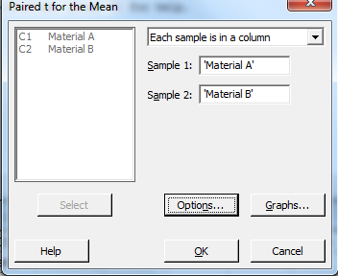
Simple Experiments: Hypothesis Testing
Paired t test in Minitab
>Stat
>Basic Statistics
>Paired t

Slide 120
Simple Experiments: Hypothesis Testing
Paired t test in Minitab
Paired T-Test and CI: Material A, Material B
Paired T for Material A - Material B
N Mean StDev SE Mean
Material A 10 10.630 2.451 0.775
Material B 10 11.040 2.518 0.796
Difference 10 -0.410 0.387 0.122
95% CI for mean difference: (-0.687, -0.133)
T-Test of mean difference = 0 (vs ≠ 0): T-Value = -3.35 P-Value = 0.009
Since p-value = 0.009 < α=0.05, we reject H₀, therefore we believe there IS a difference in wear between materials A and B.

Slide 121
Simple Experiments: Hypothesis Testing
Paired t test: Boys Shoe Example
What if we had evaluated the data using a t test to compare the mean wear of material A and material B (assume equal variances)?
Two-sample T for Material A vs Material B
N Mean StDev SE Mean
Material A 10 10.63 2.45 0.78
Material B 10 11.04 2.52 0.80
Difference = μ (Material A) - μ (Material B)
Estimate for difference: -0.41
95% CI for difference: (-2.74, 1.92)
T-Test of difference = 0 (vs ≠): T-Value = -0.37 P-Value = 0.716 DF = 18
Both use Pooled StDev = 2.4851

Slide 122
Simple Experiments: Hypothesis Testing
Paired t test: Boys Shoe Example
Using a t test to compare the mean wear of material A and material B (assume equal variances) we conclude……
Since p-value=0.716 > α=0.05 we accept H0: μ_{A}=μ_{B}
Therefore, we believe no difference in wear between material A and B
However, this is not the correct analysis because it does not block out the differences between boys
This example shows how you can reach the wrong conclusion if you do not use the proper test.

Slide 123
Relationship between Hypothesis Test and CI
Close relationship between CI and hypothesis test
For a specific significance level, α, a CI is more informative than performing a hypothesis test.
The decision made by the hypothesis test can be deduced from the confidence interval by looking to see whether μ₀ is inside the confidence interval or not.
Thus the confidence interval portrays the decisions made by hypothesis test for all possible values of μ₀ (for a given α)
However, for a specific sample, a hypothesis test is more informative than performing a CI because the hypothesis test can quickly show decisions (accept or reject) for a variety of significance levels, α.

Slide 124
HW#1 here
Due date =
Unless otherwise stated, you may use Minitab to do HW assignments
If submitting HW electronically, submit one (1) file only !!!
Can copy Minitab output and paste into MS Word. Use ‘Courier New’ font when pasting Minitab output in MS Word.
Indicate where the answer is located in Minitab output (circle, highlight, etc.)
Submit Word, Excel, or PDF files (Minitab supplemental files are ok). NO .jnt files!

Slide 125
Simple Experiments and Design of Experiments
We reviewed several simple two-sample, comparative experiments
Compare response at two factor levels
Compare mean yield rates for two catalysts
Compare mean wear for two shoe sole materials
This DOE course extends these simple experiments to more than two factor levels
The main analysis technique we’ll use in this class, ANOVA, is an extension of a t test

Slide 126
What If There Are More Than Two Factor Levels?
The t-test does not directly apply
There are lots of practical situations where there are either more than two levels of interest, or there are several factors of simultaneous interest
The analysis of variance (ANOVA) is the appropriate analysis “engine” for these types of experiments – Chapter 3, textbook
The ANOVA was developed by Fisher in the early 1920s, and initially applied to agricultural experiments
Used extensively today for industrial experiments

Slide 127
Single Factor Designed Experiment
Does factor affect the response?
Collect observations (i.e. measure response) at each of a levels (or treatments or settings) of the factor through replication (repeated experimentation).
n₁ observations at level 1 n₁ replicates at level 1
n₂ observations at level 2 n₂ replicates at level 2
•••
n_{a} observations at level a n_{a} replicates at level a
Total observations = N = n₁ + n₂ + ••• + n_{a}
If n₁ = n₂ = ••• = n_{a} then balanced design, otherwise unbalanced design
When all N observations collected in random order, then completely randomized design (CRD)

Slide 128
Single Factor Designed Experiment
Level (treatment) | Observations Y_{ij} = ij^{th} observation (factor level i, replicate j) |  |  |  | Totals | Averages
1 | Y₁₁ | Y₁₂ | • • • | Y_{1n1} | Y _{1•} | Y _{1•}
2 | Y₂₁ | Y₂₂ | • • • | Y_{2n2} | Y _{2•} | Y _{2•}
 | • • • | • • • | • • • | • • • | • • • | • • •
a | Y_{a1} | Y_{a2} | • • • | Y_{ana} | Y _{a•} | Y _{a•}
 |  |  |  |  | Y•• | Y••
Dot (•) indicates we sum over that subscript
Use ANOVA (Analysis of Variance) to determine if factor affects response
Objective of ANOVA is to test hypotheses about the equality of the a factor level means

Slide 129
Chapter 3 The Analysis of Variance (ANOVA)

Slide 130
The Analysis of Variance (ANOVA)
Objective of ANOVA is to test hypotheses about the equality of the a factor level means
H₀: μ₁ = μ₂ = ••• = μ_{a}
H₁: at least one mean is different
H₀: factor does not affect response
H₁: factor does affect response
μ₁
μ₃
μ₂
μ₁
μ₂
μ₃
Distribution of responses from at 3 factor levels
μ₃
μ₁
μ₂

Slide 131
The Analysis of Variance (ANOVA)
The basic single-factor ANOVA model is
Y_{ij} = ij^{th} observation (factor level i, replicate j). A random variable.
μ = the overall mean common to all factor levels. A constant.
τ_{i} = the i^{th} factor level effect. A constant for each factor level, i.
ε_{ij} = random error. A random variable. ε_{ij}~ NID(0, σ²)
Therefore, Y_{ij} ~ NID (μ+τ_{i}, σ²)

Slide 132
The ANOVA Normality Assumption
The ANOVA is a parametric test – it assumes the data (i.e. responses) are Normally distributed
ANOVA assumes data for each factor level is normally distributed; not overall data
If response is not normally distributed, an ANOVA may increase the chance of a false positive result
HOWEVER, the ANOVA is not very sensitive to moderate deviations from normality
simulation studies, using a variety of non-normal distributions, have shown that the false positive rate is not affected very much by this violation of the normality assumption
Can do a histogram of responses for each factor level
if they look Normally distributed, proceed with ANOVA. If not, try a data transformation. If still not Normal, use non-parametric analysis.
Many data sets would fail a goodness of fit test for Normality and still be appropriate for ANOVA

Slide 133
The Analysis of Variance (ANOVA)
The name “analysis of variance” stems from a partitioning of the total variability in the response variable into components
Total variability is measured by the total sum of squares:

Slide 134
The Analysis of Variance (ANOVA)
The basic ANOVA partitioning is:
SS_{Total}
SS_{Factor}
SS_{Error}
SS_{Total} = SS_{Factor} + SS_{Error}

Slide 135
Total Variability: SS_{Total}
Factor Level 1 Factor Level 2 Factor Level 3

Slide 136
Between Factor Level Variability: SS_{Factor}
Factor Level 1 Factor Level 2 Factor Level 3

Slide 137
Within Factor Level Variability (i.e. random error): SS_{Error}
Factor Level 1 Factor Level 2 Factor Level 3

Slide 138
The Analysis of Variance (ANOVA)
SS_{Total} = SS_{Factor} + SS_{Error}
A large value of SS_{Factor} reflects large differences in factor level means (i.e. factor DOES affect response)
A small value of SS_{Factor} likely indicates no differences in factor level means (i.e. factor DOES NOT affect response)
To reduce rounding errors, use following formulas:

Slide 139
The Analysis of Variance (ANOVA)
Objective of ANOVA is to test hypotheses about the equality of the a factor level means
Formal statistical hypotheses are:
H₀: μ₁ = μ₂ = • • • = μ_{a}
H₁: At least one mean is different
While sums of squares cannot be directly compared to test the hypothesis of equal means, mean squares can be compared.

Slide 140
The Analysis of Variance (ANOVA)
A mean square is a sum of squares divided by its degrees of freedom:

Slide 141
The Analysis of Variance (ANOVA)
Use F test to compare variances
The reference distribution for F₀ is the F_{α,a-1,N-a} distribution
Reject the null hypothesis (H₀: equal factor level means) if

Slide 142
ANOVA Table
Source of Variation | SS | df | MS | F
Factor | SS_{Factor} | a-1 | MS_{Factor}
Error | SS_{Error} | N-a | MS_{Error}
Total | SS_{Total} | N-1

Slide 143
ANOVA
Basic Idea….
Compare average response for each factor level
If big difference between factor level average responses, we believe the factor does affect the response (i.e. it matters which level you choose because different levels can lead to very different responses)
How big a difference between factor level average responses needed for us to believe factor affects response?
Compare variability between factor level average responses to random error (i.e. variability within factor levels)
Use statistical test to do above comparison

Slide 144
ANOVA Example
Blood Coagulation Example
Does diet affect the blood coagulation times of mice?
Test 4 diets (A, B, C, D) on 24 mice. Each mouse receives one diet. Data collected in completely randomized order.
Response: Blood coagulation time
Factor: diet
Factor levels: diet A, diet B, diet C, diet D
Replicates: diet A = 4, diet B = 6, diet C = 6, diet D = 8
The resulting blood coagulation times (in minutes) follow
Unbalanced design
Diet | Blood Coagulation Time (min) |  |  |  |  |  |  |  | Total | Average
A | 62 | 60 | 59 | 63 |  |  |  |  | 244 | 61
B | 63 | 67 | 71 | 64 | 65 | 66 |  |  | 396 | 66
C | 68 | 66 | 71 | 67 | 68 | 68 |  |  | 408 | 68
D | 56 | 62 | 60 | 61 | 63 | 64 | 63 | 59 | 488 | 61
 |  |  |  |  |  |  |  |  | 1536 | 64

Slide 145
ANOVA Example
Blood Coagulation Example
Results in Order Collected
i.e. randomized data collection
Summarized Results Table
Diet | Blood Coagulation Time (min)
A | 62 | 60 | 59 | 63
B | 63 | 67 | 71 | 64 | 65 | 66
C | 68 | 66 | 71 | 67 | 68 | 68
D | 56 | 62 | 60 | 61 | 63 | 64 | 63 | 59

Slide 146
ANOVA Example
H₀: μ_{A}=μ_{B}=μ_{C}=μ_{D}
H₁: at least one mean is different
a = 4 N = 24
H₀: factor does not affect response
H₁: factor does affect response

Slide 147
ANOVA Example
ANOVA Table
H₀: μ_{A}=μ_{B}=μ_{C}=μ_{D}
Reject H₀ if F₀ > F_{α,a-1,N-a}
F_{0.05,3,20} = 3.10
Since 13.57 > 3.10 we reject H₀
We believe diet does affect blood coagulation time
Source of Variation | SS | df | MS | F
Diet | 228 | 3 | 76 | 13.57
Error | 112 | 20 | 5.6
Total | 340 | 23
H₀: factor does not affect response
H₁: factor does affect response

Slide 148
Cake Baking Example
Does # eggs affect cake height?
Response: cake height (inches)
Factor: # eggs
Factor levels: 2, 3, 4 eggs
Replicates: 5
Data collected in completely randomized order
H₀: μ_{2eggs} = μ_{3eggs} = μ_{4eggs}
H₁: at least one mean is different
Balanced design
Your best guess: Does the number of eggs affect cake height?
Yes No Why?

Slide 149
Cake Baking Example
ANOVA Table
Does the number of eggs affect cake height?
Use α = 0.05 F_{0.05,2,12} = 3.89
H₀: μ_{2eggs} = μ_{3eggs} = μ_{4eggs}
Since 21.91 > 3.89 we reject H₀
i.e. we reject the hypothesis that the average cake height is approximately the same whether we use 2, 3, or 4 eggs
Conclude number of eggs does affect cake height
Source of Variation | SS | df | MS | F
# eggs | 1.577 | 2 | 0.789 | 21.91
Error | 0.432 | 12 | 0.036
Total | 2.009 | 14
H₀: factor does not affect response
H₁: factor does affect response

Slide 150
Cake Baking Example
Does # eggs affect cake height?
Response: cake height (inches)
Factor: # eggs
Factor levels: 2, 3, 4 eggs
Replicates: 5
Data collected in completely randomized order
H₀: μ_{2eggs} = μ_{3eggs} = μ_{4eggs}
H₁: at least one mean is different
Balanced design
Your best guess: Does the number of eggs affect cake height?
Yes No Why?

Slide 151
Cake Baking Example
ANOVA Table
Does the number of eggs affect cake height?
Use α = 0.05 F_{0.05,2,12} = 3.89
H₀: μ_{2eggs} = μ_{3eggs} = μ_{4eggs}
Since 0.46 < 3.89 we accept H₀
i.e. we accept the hypothesis that the average cake height is approximately the same whether we use 2, 3, or 4 eggs
Conclude number of eggs does not affect cake height
Source of Variation | SS | df | MS | F
# eggs | 1.577 | 2 | 0.789 | 0.46
Error | 20.392 | 12 | 1.699
Total | 21.969 | 14
H₀: factor does not affect response
H₁: factor does affect response

Slide 152
Post-ANOVA Comparison of Means
The analysis of variance tests the hypothesis of equal factor level means
If that hypothesis is rejected, we don’t know which specific means are different
Determining which specific means differ following an ANOVA is called the multiple comparisons problem
There are lots of ways to do this…see text, Section 3-5
We will use pairwise comparison of means
Confidence intervals
Tukey test

Slide 153
Comparison Among Factor Level Means
Confidence Interval comparison of Means
100(1-α)% CI on difference between any 2 factor level means, μ_{i}-μ_{j}
If 0 in interval, then NO significant difference between factor level means
d.f. for MS_{E}

Slide 154
Comparison Among Factor Level Means
For blood coagulation example
Find 90% CI on difference in blood coagulation times between diets A and B
(-7.635, -2.365)
Significant difference in the average blood coagulations times produced by diets A and B?

Slide 155
Comparison Among Factor Level Means
Tukey test
Compare all pairs of factor level means
Two factor level means are significantly different if
Where a= # factor levels; f = d.f. for MS_{E}
Based on studentized range statistic – a table lookup value

Slide 156
Comparison Among Factor Level Means
Tukey test for blood coagulation example
q_{0.05}(4,20)=3.96 from Table VII
A vs B
A vs C
Pairs sig. different?

Slide 157
Comparison Among Factor Level Means
Pairs sig. different?
A vs D
B vs C
B vs D
C vs D

Slide 158
Comparison Among Factor Level Means
Results can be expressed graphically
60 62 64 66 68 70
Bars under factor level labels indicate pairs are NOT significantly different
To maximize blood coagulation time, choose diet B or C? diet A or B?

Slide 159
Pairwise Comparisons
Possible to get seemingly paradoxical results
1 and 2 not significantly different
1 and 3 not significantly different
Does this imply 2 and 3 not significantly different? NO!
2 and 3 are significantly different
Saying a pair is not significantly different is not the same as saying they are equal.
The transitive property (A=B and B=C therefore A=C) is not in effect
We know 2 and 3 are significantly different and 1 is somewhere between 2 and 3
Choose either 2 or1 to maximize response
Which levels maximize avg. response?
Which levels minimize avg. response?

Slide 160
Pairwise Comparisons
It is possible for ANOVA and Pairwise Comparisons to contradict
ANOVA indicates factor significance (p-value < α) but Tukey test indicates no significantly different factor levels at α
ANOVA indicates no factor significance (p-value > α) but Tukey test indicates significantly different factor levels at α
Tukey test uses family error rate
the chances of making a type I error for a series of comparisons is greater than the error rate for any one comparison alone.
Family error = 1 – (1- individual error) ª where a = # factor levels
For a=5 levels and individual error =0.05, family error = 1 – (1 - 0.05)⁵ = 0.2262
For a=5 levels and family error =0.05, individual error = 1 - ⁵√(1 – 0.05) = 0.0102
To counter this higher family error rate, Tukey's method adjusts the confidence level for each individual interval so that the resulting simultaneous confidence level is equal to the value you specify.

Slide 161
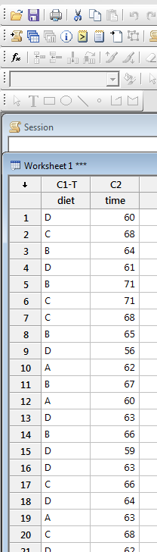
ANOVA in Minitab
Enter data in worksheet
One column for factor levels
Older versions of Minitab require factor levels to be numeric
One column for observations
Enter data in actual run order

Slide 162
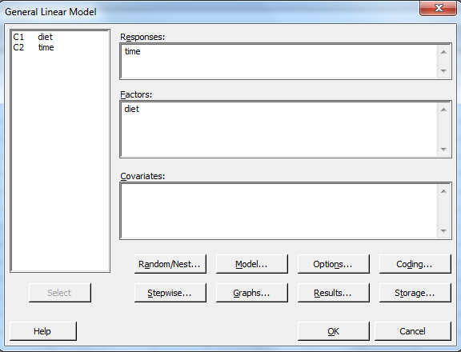
ANOVA in Minitab
Stat
ANOVA
General Linear Model
Fit General Linear Model

Slide 163
ANOVA in Minitab
General Linear Model: time versus diet
Factor Type Levels Values
diet fixed 4 A, B, C, D
Analysis of Variance for time, using Adjusted SS for Tests
Source DF Seq SS Adj SS Adj MS F P
diet 3 228.000 228.000 76.000 13.57 0.000
Error 20 112.000 112.000 5.600
Total 23 340.000
Model Summary
S R-sq R-sq(adj) R-sq(pred)
2.36643 67.06% 62.12% 53.46%
Fits and Diagnostics for Unusual Observations
Obs time Fit Resid Std Resid
5 71.00 66.00 5.00 2.31 R
9 56.00 61.00 -5.00 -2.26 R
R denotes an observation with a large standardized residual.
When p-value < α we reject H₀ (i.e. conclude factor DOES affect response)

Slide 164
p-value
p-value = probability of obtaining this F₀ or larger when the null hypothesis is true
We reject H₀ (i.e. factor is significant) for all p-value < α
Reject H₀ (i.e. factor is significant) for small p-values
p = 0.03 accept or reject H₀? Depends on α
When α = 0.05, reject H₀
When α = 0.01, accept H₀
Relationship between F₀ and p-value
As F₀ increases, p-value decreases
As F₀ decreases, p-value increases
As F₀ approaches F_{α,v1,v2}, p-value approaches α
Same α

Slide 165
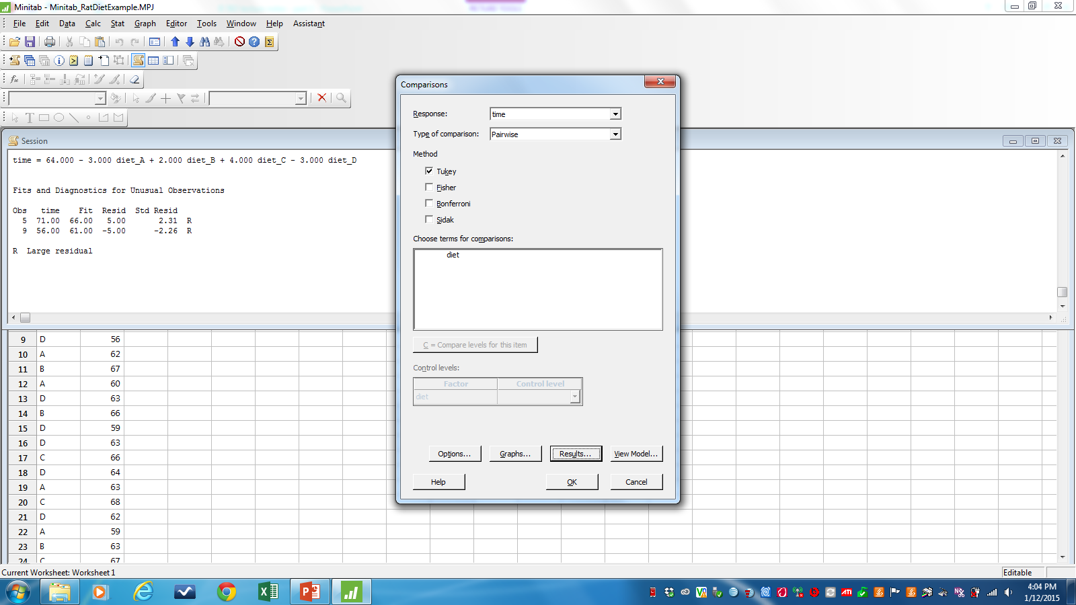
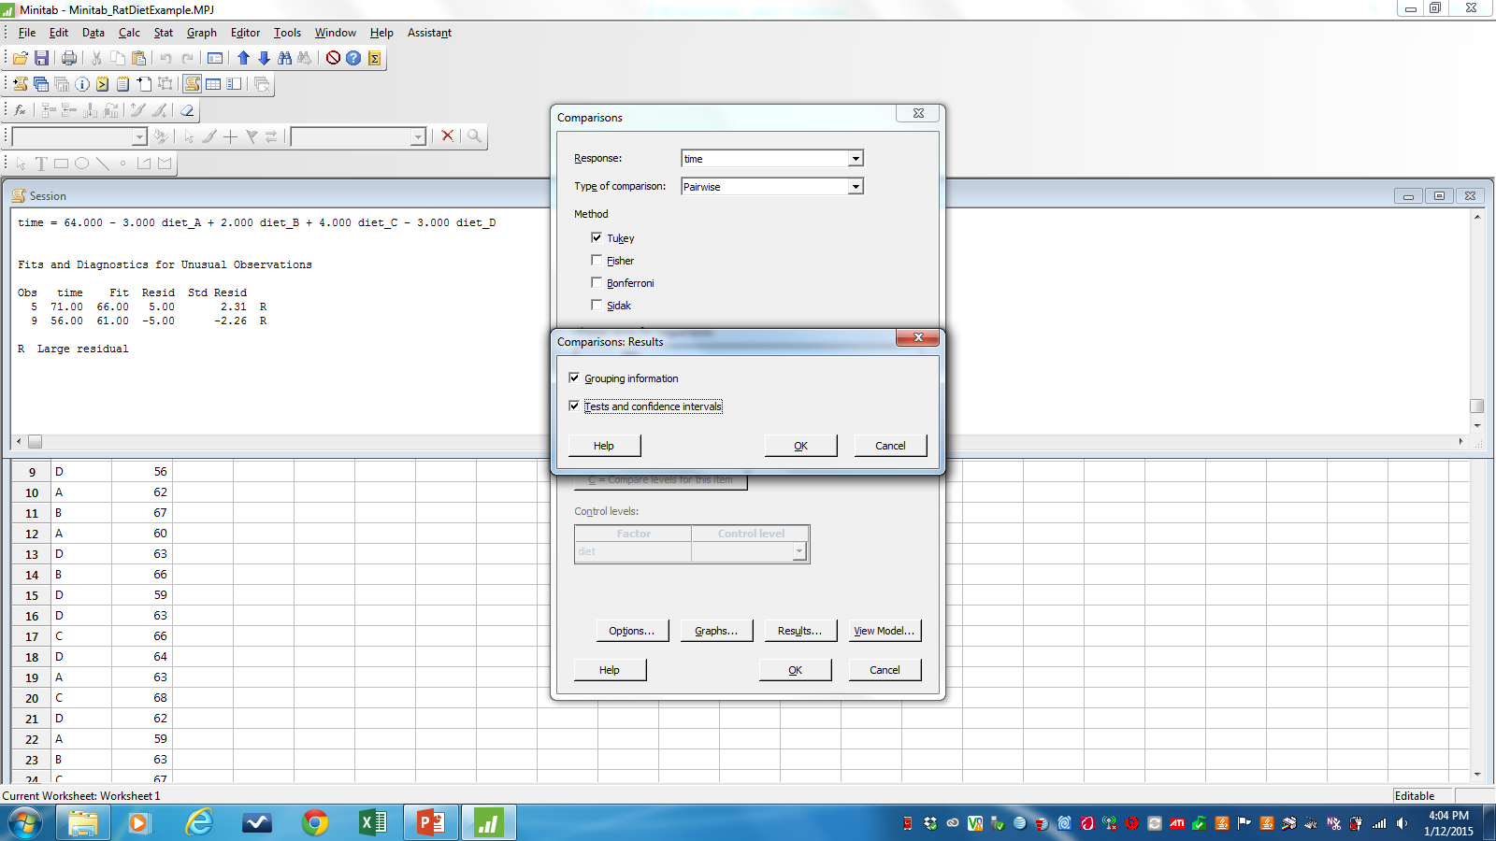
Minitab: Tukey procedure
Stat
ANOVA
GLM: General Linear Model
Comparisons
To change confidence level

Slide 166
Minitab: Tukey Test
Tukey Simultaneous Tests
Response Variable time
All Pairwise Comparisons among Levels of diet
Tukey Simultaneous Tests for Differences of Means
Difference
of diet Difference SE of Simultaneous Adjusted
Levels of Means Difference 95% CI T-Value P-Value
B - A 5.00 1.53 ( 0.72, 9.28) 3.27 0.018
C - A 7.00 1.53 ( 2.72, 11.28) 4.58 0.001
D - A -0.00 1.45 ( -4.06, 4.06) -0.00 1.000
C - B 2.00 1.37 ( -1.83, 5.83) 1.46 0.477
D - B -5.00 1.28 ( -8.58, -1.42) -3.91 0.004
D - C -7.00 1.28 (-10.58, -3.42) -5.48 0.000
Individual confidence level = 98.89%
P-value < α? then sig. diff.

Slide 167
Multiple Comparisons
Tukey Test
Often helpful to analyze Minitab Tukey Test output in organized fashion
Start with level with maximum (minimum) avg. response; compare to levels in decreasing (increasing) order; stop when first significant difference found
e.g. Which diet(s) maximize blood coagulation time?

Slide 168
Minitab: Tukey Test
P-value < α? then sig. diff.
Tukey Simultaneous Tests
Response Variable time
All Pairwise Comparisons among Levels of diet
Tukey Simultaneous Tests for Differences of Means
Difference
of diet Difference SE of Simultaneous Adjusted
Levels of Means Difference 95% CI T-Value P-Value
B - A 5.00 1.53 ( 0.72, 9.28) 3.27 0.018
C - A 7.00 1.53 ( 2.72, 11.28) 4.58 0.001
D - A -0.00 1.45 ( -4.06, 4.06) -0.00 1.000
C - B 2.00 1.37 ( -1.83, 5.83) 1.46 0.477
D - B -5.00 1.28 ( -8.58, -1.42) -3.91 0.004
D - C -7.00 1.28 (-10.58, -3.42) -5.48 0.000
Individual confidence level = 98.89%

Slide 169
Minitab: Tukey Test
Interval contains 0? then no sig. diff.
Tukey Simultaneous Tests
Response Variable time
All Pairwise Comparisons among Levels of diet
Tukey Simultaneous Tests for Differences of Means
Difference
of diet Difference SE of Simultaneous Adjusted
Levels of Means Difference 95% CI T-Value P-Value
B - A 5.00 1.53 ( 0.72, 9.28) 3.27 0.018
C - A 7.00 1.53 ( 2.72, 11.28) 4.58 0.001
D - A -0.00 1.45 ( -4.06, 4.06) -0.00 1.000
C - B 2.00 1.37 ( -1.83, 5.83) 1.46 0.477
D - B -5.00 1.28 ( -8.58, -1.42) -3.91 0.004
D - C -7.00 1.28 (-10.58, -3.42) -5.48 0.000
Individual confidence level = 98.89%

Slide 170
Minitab: Tukey Test

Slide 171
Minitab: Tukey Grouping
Grouping Information Using the Tukey Method and 95% Confidence
diet N Mean Grouping
C 6 68 A
B 6 66 A
A 4 61 B
D 8 61 B
Means that do not share a letter are significantly different.
Choose diet C or B to maximize blood coagulation time
Choose diet A or D to minimize blood coagulation time

Slide 172
Minitab Demo Here
Demo ANOVA in Minitab
Worksheet ‘blood.mtw’
Demo Tukey Test & CI in Minitab

Slide 173
Another example
Problem 3-19
Four chemists are asked to determine the percentage of methyl alcohol in a certain chemical compound. Each chemist makes three determinations. The following data is collected in a completely randomized order
Do the chemists differ significantly?
Response?
Factor?
Factor levels?
# replicates?

Slide 174
Problem 3-19 (cont.)
From Minitab
General Linear Model: % MA versus chemist
Factor Type Levels Values
chemist fixed 4 1, 2, 3, 4
Analysis of Variance for % MA
Source DF Seq SS Adj SS Adj MS F P
chemist 3 1.0446 1.0446 0.3482 3.25 0.081
Error 8 0.8582 0.8582 0.1073
Total 11 1.9028
H₀: μ₁=μ₂=μ₃=μ₄
Conclusion? Do the chemists differ?
Do pairwise comparison (Tukey) of the chemists?

Slide 175
HW#2 here
Due date =
Unless otherwise stated, you may use Minitab to do HW assignments
If submitting HW electronically, submit one (1) file only !!!
Can copy Minitab output and paste into MS Word. Use ‘Courier New’ font when pasting Minitab output in MS Word.
Indicate where the answer is located in Minitab output (circle, highlight, etc.)
Data sets can be copied from assignment document and pasted into Excel or Minitab. Some data sets may need to be rearranged before conducting an analysis in Minitab

Slide 176
ANOVA Model Adequacy Checking
ANOVA based on several assumptions
Check to see if these assumptions are valid. If not, do not use ANOVA.
Random error, ε_{ij}, assumed to be NID(0, σ²)
Error normally distributed
Error independently distributed
Error has mean of 0
Error has constant variance

Slide 177
Model Adequacy Checking
We use residuals, e_{ij}, as estimator of random error ε_{ij}
Residual is difference between actual observation and estimated observation
Calculation of estimated observation depends on model
For single factor ANOVA:
So, for single factor ANOVA

Slide 178
Model Adequacy Checking
each observation has a residual (i.e. there are N residuals)
Residual is and for single factor ANOVA
Residuals for Blood Coagulation example (shown in sorted order, not random order)

Slide 179
Model Adequacy Checking
Random error, ε_{ij}, assumed to be NID(0, σ²)
Residuals Normally distributed?
Check normal probability plot of residuals
Straight line?
Residuals have a mean of zero?
Check normal probability plot of residuals
Centered around zero?
Residuals independently distributed?
Check residuals vs run order plot
No patterns?
Residuals have a constant variance?
Check residuals vs predicted value (fit) plot
No patterns?

Slide 180
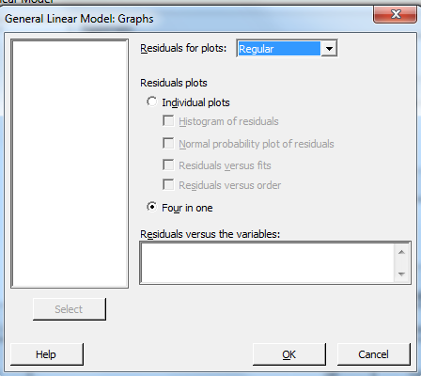
Model Adequacy Checking
General Linear Model Window
Graphs

Slide 181
Model Adequacy Checking

Slide 182
Residual Analysis Residuals normally distributed with mean of 0?
Normal probability plot – straight line centered at 0?
Moderate departures from normality OK for fixed effects model
If really not a straight line (i.e. not normally distributed) try transformation; if normality assumption still not good, use nonparametric test
Outliers
Common occurrence
Make sure data collected and recorded properly
Do not automatically discard outliers
Possible outliers: observations with standardized residuals greater than 3 or less than -3 (we expect 99.73% of observations to have standardized residuals between -3 and 3)
Standardized residual _{ij} =

Slide 183
Residual Analysis Nonnormal responses and transformations
If response not Normally distributed, then can try transformation
ANOVA is OK for moderate departures from normality
Nonnormal Responses relatively common in practice
Count # defects
Distance from target skewed resp. distr. (bounded on 1 side)
Any %
Transform the response, Y, values
Which transformation to use? Trial and error or Box-Cox method
Common transformations: 1/Y, √Y, 1/√Y, ln(Y), log₁₀(Y)
Conclusions apply to transformed data
Do reverse transformation

Slide 184
Residual Analysis Nonnormal responses and transformations
Box-Cox Transformation Method
Transform response, Y, using power family of transformations:
What λ to use?
Choose λ to transform response to normality
Minitab will determine best λ value
Cannot use Box-Cox transformation if any responses are 0 or negative
Add constant to responses to make > 0
Be sure to subtract constant (and do reverse transformation) when drawing conclusions and making predictions

Slide 185
Residual Analysis Nonnormal responses and transformations
Transform response, Y, using Box-Cox transformation in Minitab

Slide 186
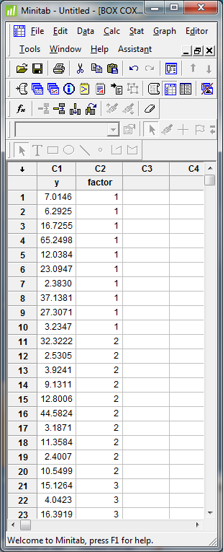
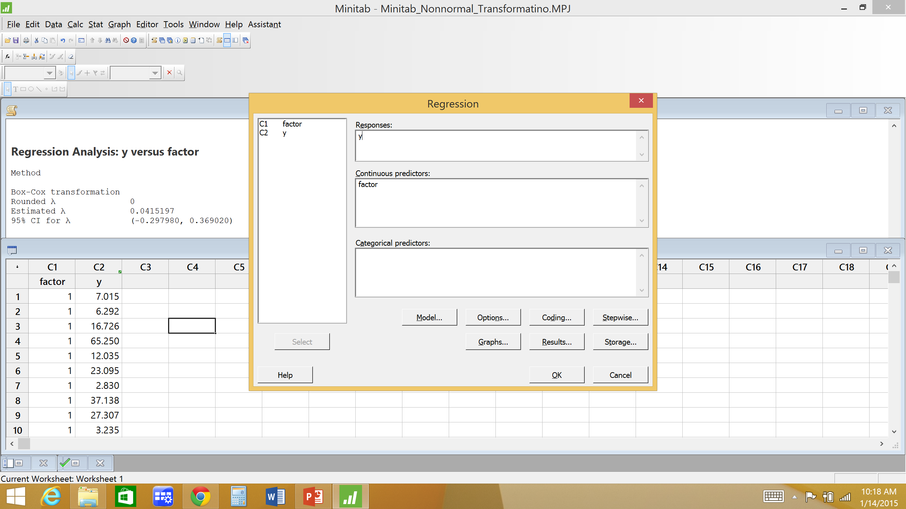
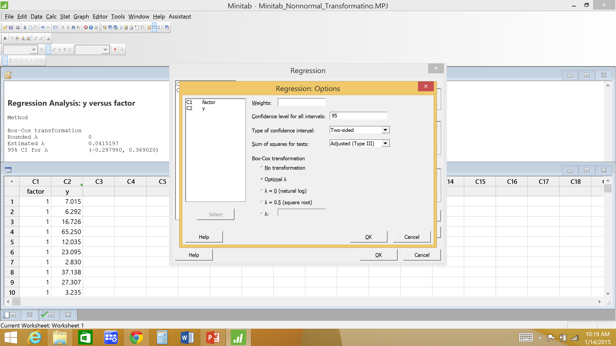
Residual Analysis Nonnormal responses and transformations
Box-Cox transformation in Minitab
Transform response in >Regression >General Regression
Then use transformed response in ANOVA
In Minitab:
Stat
Regression
Regression
Fit Regression Model
Options

Slide 187
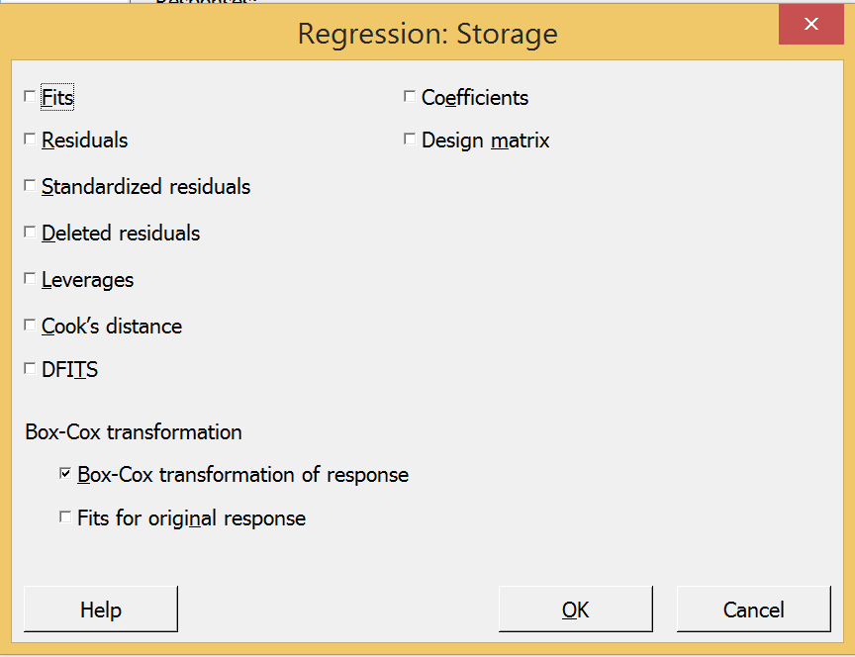
Residual Analysis Nonnormal responses and transformations
Box-Cox transformation in Minitab
Transform response in >Regression >General Regression
Then use transformed response in ANOVA
In Minitab:
Stat
Regression
Regression
Fit Regression Model
Options
Store Transformed Response

Slide 188
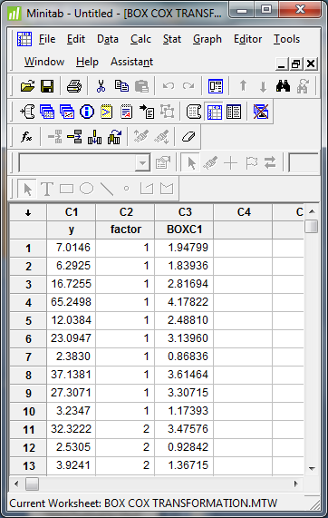
Residual Analysis Nonnormal responses and transformations
Box-Cox transformation in Minitab
Use value of λ that makes practical sense – use rounded λ
General Regression Analysis: y versus factor
Box-Cox transformation
Rounded λ 0
Estimated λ 0.0415197
95% CI for λ (-0.297980, 0.369020)
Regression Equation
ln(y) = 2.335 + 0.0005 factor
ln(y) = BOXC1
e.g. ln(7.015) = 1.94799

Slide 189
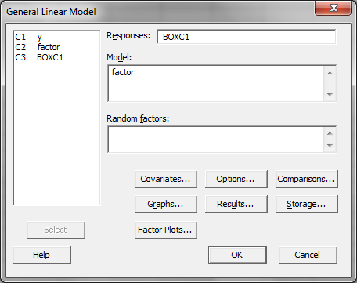
Residual Analysis Nonnormal responses and transformations
Box-Cox transformation in Minitab
Transform response in >Regression >General Regression
Then use transformed response in ANOVA
Remember: ANOVA conclusions apply to transformed data
Do reverse transformation

Slide 190
Residual Analysis Residuals independently distributed?
Residual vs time – random scatter plot?
If not a random scatter plot indicates correlation between residuals – i.e. not independently distributed
Causes of correlation
Skill of subjects or experimenter changes over time
Equipment wear will change responses over time
Experiment not properly randomized
e_{ij}
e_{ij}
0
0
Time
Time
Positive correlation
Negative correlation

Slide 191
Residual Analysis Residuals have constant variance?
Statistical test - Bartlett’s Test
Residual vs fitted value – random scatter plot?
Sometimes variance of observation changes as magnitude of observation increases (i.e. residuals correlated with magnitude of response)
If residual variance nonconstant, then can try transformation
Transform the response, Y, values
Which transformation to use? Box-Cox method
Conclusions apply to transformed data
Do reverse transformation
e_{ij}
e_{ij}
Funnel – nonconstant variance
0
0
Fitted Y
Fitted Y

Slide 192
Residual Analysis nonconstant residual variance and transformations
variance stabilizing transformation example

Slide 193
Residual Analysis nonconstant residual variance and transformations
variance stabilizing transformation example
Box-Cox transformation of the response with estimated lambda = 0.200235
The 95% CI for lambda is (-0.201265, 0.604735)
Rounded lambda = 0 used in the regression analysis
Regression Equation
ln(y) = 2.43901 - 0.504436 factor level
ln(Y) = BOXC2
e.g. ln(6.09) = 1.80665

Slide 194
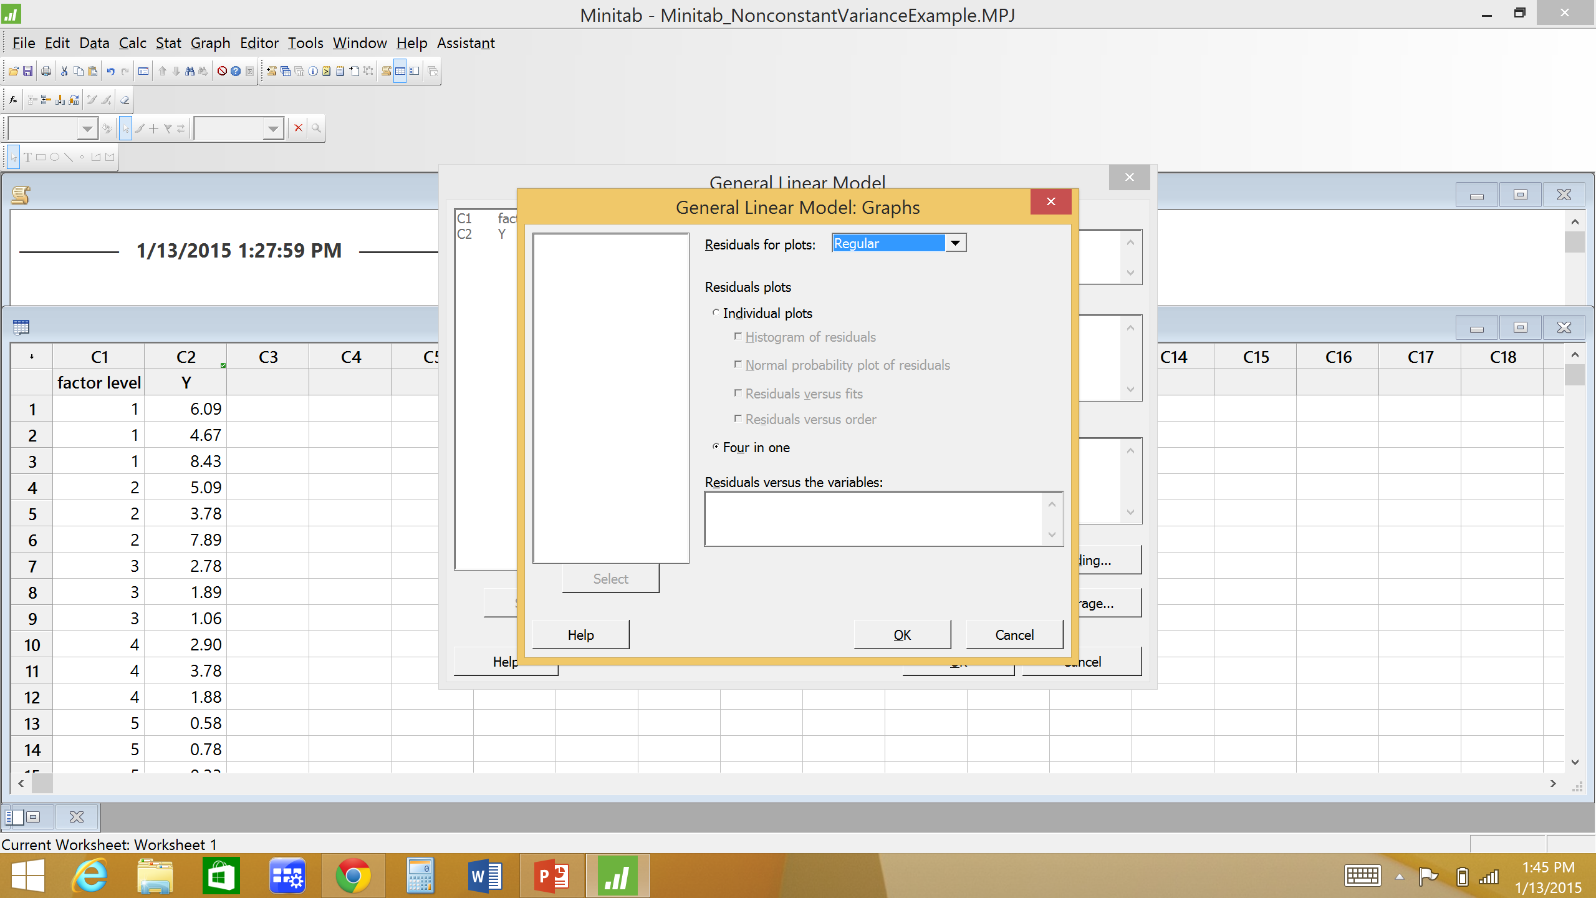
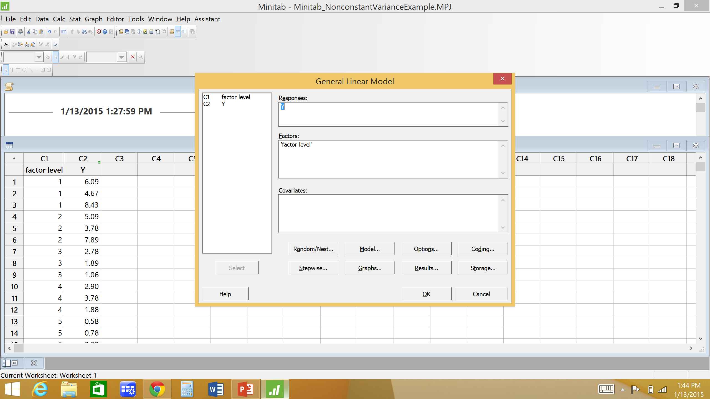
Residual Analysis
In Minitab
Stat
ANOVA
General Linear Model (Fit General Linea Model)
Graphs
Four in one

Slide 195
Minitab residual analysis for blood coagulation example

Slide 196
Minitab residual analysis for problem 3-19 (Chemists)

Slide 197
Regression Analysis
Now we are ready to draw practical conclusions
Use Regression Analysis to build a mathematical model relating response to factor(s)
Simple linear regression (single factor)
Multiple linear regression

Slide 198
Regression Analysis
An experimenter is often interested in how a particular variable depends upon one or more of the other variables.
Modeling is often performed by finding a functional relationship between the expected value of a dependent variable, Y, and a set of independent variables, X_{i}.
How does X affect Y? What is the effect of X on Y?
Linear Regression is a modeling technique in which the expected value of a dependent variable is modeled as a linear combination of a set of independent variables.
Many problems in engineering and science involve exploring the relationships between two or more variables.

Slide 199
Regression Analysis
Example
A company that makes paper grocery bags is interested in improving the tensile strength of their bags. Specifically they are interested in the relationship between the hardwood concentration in the pulp and the tensile strength of the bag.
Regression analysis can be used to build a model to relate tensile strength (Y) to hardwood concentration (X).

Slide 200
Regression Analysis
Consider ANOVA
General Linear Model: strength versus hardwood
Factor Type Levels Values
hardwood fixed 4 5, 10, 15, 20
Analysis of Variance
Source DF Adj SS Adj MS F-Value P-Value
hardwood concentration 3 382.8 127.597 19.61 0.000
Error 20 130.2 6.508
Total 23 513.0

Slide 201
Regression Analysis
ANOVA tells us hardwood concentration affects bag tensile strength
What is their relationship? Develop mathematical model relating hardwood concentration and tensile strength

Slide 202
Regression Analysis
Based on the scatter diagram, it is probably reasonable to assume that the variable Y is related to X by the following simple linear regression model :
Y = β₀ + β₁X + ε
where the slope, β₁, and intercept, β₀, of the line are called regression coefficients and where ε is the random error term.
ε ~NID (0, σ²)

Slide 203
Simple Linear Regression
The case of simple linear regression considers a single regressor or predictor or independent variable X and a dependent or response variable Y.
1 term in regression model (not counting constant)
How to fit line to data? How to find values for slope, β₁, and intercept, β₀?
find slope, β₁, and intercept, β₀, of best fitting line.

Slide 204
Simple Linear Regression
Used when demand is linearly increasing or decreasing over time
Find ‘best’ fitting line to data

Slide 205
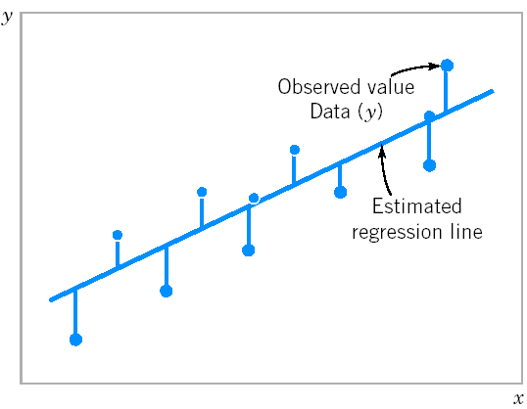
Simple Linear Regression
The method of least squares is used to estimate the parameters, β₀ and β₁ by minimizing the sum of the squares of the vertical deviations in Figure below.
Figure Deviations of the data from the estimated regression model.

Slide 206
Simple Linear Regression
The sum of the squares of the deviations of the observations from the true regression line is
How to find β₀ and β₁ that minimize L?

Slide 207
Simple Linear Regression
The least squares estimates of the intercept and slope in the simple linear regression model are
Fitted or estimated regression line is

Slide 208
Simple Linear Regression
Fit a simple linear regression model to paper bag example

Slide 209
Simple Linear Regression
Y = 7.25 + 0.697*X
Strength = 7.25 + 0.697*Hardwood

Slide 210
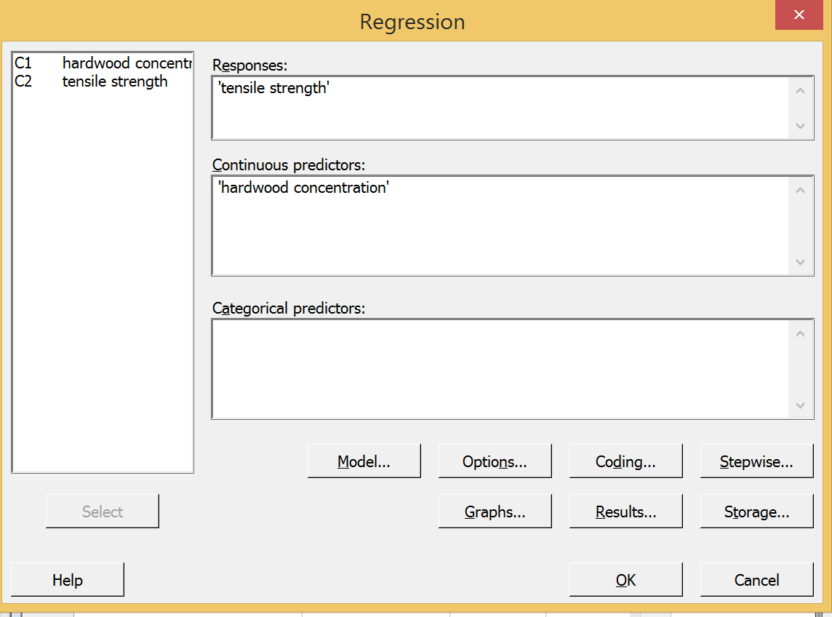
Regression Analysis in Minitab
Data in 2 columns: response (Y) & factor (X)
Stat
Regression
Regression
Fit Regression Model

Slide 211
Regression Analysis in Minitab
Regression Analysis: strength versus hardwood
Analysis of Variance
Source DF Adj SS Adj MS F-Value P-Value
Regression 1 364.01 364.008 53.76 0.000
hardwood concentration 1 364.01 364.008 53.76 0.000
Error 22 148.95 6.770
Lack-of-Fit 2 18.78 9.392 1.44 0.260
Pure Error 20 130.17 6.508
Total 23 512.96
Model Summary
S R-sq R-sq(adj) R-sq(pred)
2.60201 70.96% 69.64% 65.18%
Coefficients
Term Coef SE Coef T-Value P-Value VIF
Constant 7.25 1.30 5.57 0.000
hardwood concentration 0.6967 0.0950 7.33 0.000 1.00
Regression Equation
tensile strength = 7.25 + 0.6967 hardwood concentration

Slide 212
Prediction of New Observations
If x₀ is the value of the regressor variable of interest,
is the point estimator of the new or future value of the response, Y₀.
Predict bag strength for a hardwood concentration of 8%
Strength = 7.25 + 0.697(8) = 12.826

Slide 213
Prediction of New Observations
A 100(1-α)% prediction interval on a future observation Y₀ at the value x₀ is given by
where
and where

Slide 214
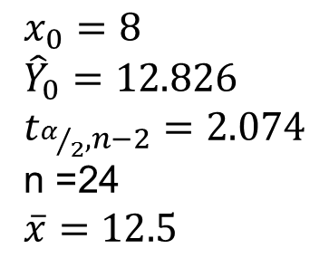
Prediction of New Observations
Find a 95% PI for the tensile strength at a hardwood concentration of x₀ = 8%
$x_{0}=8$
${\hat{Y}}_{0}=12.826$ $t_{α/2,n−2}=2.074$ n =24
$\overline{x}=12.5$
(7.28, 18.37)

Slide 215
Regression Analysis in Minitab
Regression Analysis: strength versus hardwood
Analysis of Variance
Source DF Adj SS Adj MS F-Value P-Value
Regression 1 364.01 364.008 53.76 0.000
hardwood concentration 1 364.01 364.008 53.76 0.000
Error 22 148.95 6.770
Lack-of-Fit 2 18.78 9.392 1.44 0.260
Pure Error 20 130.17 6.508
Total 23 512.96
Model Summary
S R-sq R-sq(adj) R-sq(pred)
2.60201 70.96% 69.64% 65.18%
Coefficients
Term Coef SE Coef T-Value P-Value VIF
Constant 7.25 1.30 5.57 0.000
hardwood concentration 0.6967 0.0950 7.33 0.000 1.00
Regression Equation
tensile strength = 7.25 + 0.6967 hardwood concentration

Slide 216
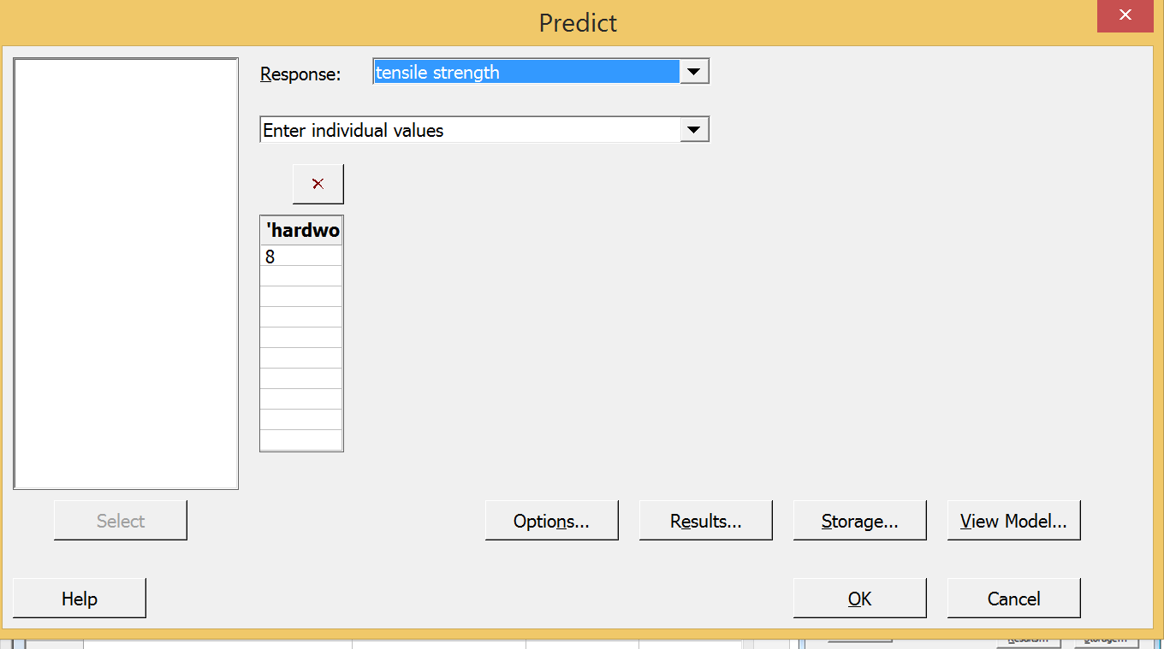
Regression Analysis in Minitab
Prediction intervals in Minitab
Stat
Regression
Regression
Predict
Change settings (i.e. 95%, etc) here

Slide 217
Regression Analysis in Minitab
Prediction for tensile strength
Regression Equation
tensile strength = 7.25 + 0.6967 hardwood concentration
Variable Setting
hardwood concentration 8
Fit SE Fit 95% CI 95% PI
12.8233 0.681839 (11.4093, 14.2374) (7.24490, 18.4018)
Difference between CI and PI:
Prediction Interval: Represents a range that a single new observation is likely to fall given specified settings of the predictors.
Confidence interval of the prediction: Represents a range that the mean response is likely to fall given specified settings of the predictors.
The PI is always wider than the corresponding CI because of the added uncertainty involved in predicting a single response versus the mean response.

Slide 218
Regression Analysis
We can fit a regression line to any data.
Is line a good fit? Will it give good predictions?
Does X have a significant effect on Y?

Slide 219
Adequacy of the Regression Model
Use statistical hypotheses tests about the model parameters to assess the adequacy of a linear regression model
We can perform hypothesis testing on both the slope, β₁, and the intercept, β₀
The most important hypothesis test is on the slope, β₁ :
H₀: β₁ = 0
H₁: β₁ ≠ 0
This hypothesis relates to the significance of regression.
Failure to reject H₀ is equivalent to concluding that there is no linear relationship between X (factor) and Y (response).

Slide 220
Hypothesis Tests in Simple Linear Regression
The hypothesis H₀: β₁ = 0 is not rejected.
The hypothesis H₀: β₁ = 0 is rejected.

Slide 221
Hypothesis Tests in Simple Linear Regression
To test this significance of regression hypothesis we do an ANOVA on the regression model
Partition total sum of squares into sum of squares for regression model and sum of squares error
SS_{T} = SS_{R} + SS_{E}
Test statistic = F₀ = MS_{R}/MS_{E}
Do ANOVA on Regression equation using Minitab
How much response variability explained by regression equation

Slide 222
Regression Analysis in Minitab
Regression Analysis: strength versus hardwood
Analysis of Variance
Source DF Adj SS Adj MS F-Value P-Value
Regression 1 364.01 364.008 53.76 0.000
hardwood concentration 1 364.01 364.008 53.76 0.000
Error 22 148.95 6.770
Lack-of-Fit 2 18.78 9.392 1.44 0.260
Pure Error 20 130.17 6.508
Total 23 512.96
Model Summary
S R-sq R-sq(adj) R-sq(pred)
2.60201 70.96% 69.64% 65.18%
Coefficients
Term Coef SE Coef T-Value P-Value VIF
Constant 7.25 1.30 5.57 0.000
hardwood concentration 0.6967 0.0950 7.33 0.000 1.00
Regression Equation
tensile strength = 7.25 + 0.6967 hardwood concentration
If P-value < α, then reject H₀: β₁=0
If P-value < α, then believe there is a sig. relationship between X & Y

Slide 223
ANOVA NOTES
ANOVA from designed experiment NOT same as ANOVA from regression
In general, ANOVA shows how much variability in data can be explained and how much cannot (random error)
Designed experiment ANOVA
How much variability explained by different factor levels
Regression ANOVA shows
How much variability explained by regression equation
Designed experiment ANOVA and Regression ANOVA will have same SS_{Total}
However SS_{regression} ≠ SS_{factor} AND df_{regression} ≠ df_{factor}

Slide 224
2 different ANOVAs
ANOVA from Designed Experiment
General Linear Model: strength versus hardwood
Analysis of Variance
Source DF Adj SS Adj MS F-Value P-Value
hardwood concentration 3 382.8 127.597 19.61 0.000
Error 20 130.2 6.508
Total 23 513.0
ANOVA from Regression Analysis
Analysis of Variance
Source DF Adj SS Adj MS F-Value P-Value
Regression 1 364.01 364.008 53.76 0.000
hardwood concentration 1 364.01 364.008 53.76 0.000
Error 22 148.95 6.770
Lack-of-Fit 2 18.78 9.392 1.44 0.260
Pure Error 20 130.17 6.508
Total 23 512.96

Slide 225
Adequacy of the Regression Model
Coefficient of Determination (R²)
The quantity R² is called the coefficient of determination and is often used to judge the adequacy of a regression model
0 ≤ R² ≤ 1 or 0% ≤ R² ≤ 100%
We often refer to R² as the amount of variability in the data (i.e. responses) explained or accounted for by the regression model.

Slide 226
Adequacy of the Regression Model
Higher R² values indicate a better fit of line to data
We often refer to R² as the amount of variability in the data explained or accounted for by the regression model
No universal cut-off or threshold R² value to define ‘good fitting’ model versus ‘bad fitting model
Y
Y
X
X
Higher R²
Lower R²

Slide 227
Adequacy of the Regression Model
Coefficient of Determination (R²)
For the bag strength regression model,
R² = SS_{R}/SS_{T}
= 364.01 / 512.96
= 0.710
Thus, the model accounts for 71.0% of the variability in the responses (tensile strengths).

Slide 228
Regression Analysis in Minitab
Regression Analysis: strength versus hardwood
The regression equation is
strength = 7.25 + 0.697 hardwood
Predictor Coef SE Coef T P
Constant 7.250 1.301 5.57 0.000
hardwood 0.69667 0.09501 7.33 0.000
S = 2.60201 R-Sq = 71.0% R-Sq(adj) = 69.6%
Analysis of Variance
Source DF SS MS F P
Regression 1 364.01 364.01 53.76 0.000
Residual Error 22 148.95 6.77
Total 23 512.96
S represents the standard deviation of the distance that data values fall from the regression line (i.e. standard deviation of the residuals). The better the equation predicts the response, the lower S is.
S = √MS_{E} and is used to calculate PI

Slide 229
Regression Analysis in Minitab
Regression Analysis: strength versus hardwood
Analysis of Variance
Source DF Adj SS Adj MS F-Value P-Value
Regression 1 364.01 364.008 53.76 0.000
hardwood concentration 1 364.01 364.008 53.76 0.000
Error 22 148.95 6.770
Lack-of-Fit 2 18.78 9.392 1.44 0.260
Pure Error 20 130.17 6.508
Total 23 512.96
Model Summary
S R-sq R-sq(adj) R-sq(pred)
2.60201 70.96% 69.64% 65.18%
Coefficients
Term Coef SE Coef T-Value P-Value VIF
Constant 7.25 1.30 5.57 0.000
hardwood concentration 0.6967 0.0950 7.33 0.000 1.00
Regression Equation
tensile strength = 7.25 + 0.6967 hardwood concentration
S represents the standard deviation of the distance that data values fall from the regression line (i.e. standard deviation of the residuals). The better the equation predicts the response, the lower S is.
S = √MS_{E} and is used to calculate PI

Slide 230
R² vs P-value
R² measures amount of variability in the data explained by the regression model.
Closeness of data to regression model
P-value indicates whether relationship exists between X and Y
non-zero slope

Slide 231
Adequacy of the Regression Model
Regression analysis based on several assumptions
Check to see if these assumptions are valid.
Random error, ε_{ij}, assumed to be NID(0, σ²)
Error normally distributed
Error independently distributed
Error has mean of 0
Error has constant variance

Slide 232
Adequacy of the Regression Model
We use residuals, e_{ij}, as estimator of random error ε_{ij}
Residual is difference between actual observation and estimated observation
Calculation of estimated observation depends on model
For simple linear regression:
So, for simple linear regression

Slide 233
Adequacy of the Regression Model
Residuals Normally distributed?
Check normal probability plot of residuals
Straight line? If not, use Box-Cox transformation
Residuals have a mean of zero?
Check normal probability plot of residuals
Centered around zero?
Residuals independently distributed?
Check residuals vs run order plot
No patterns?
Residuals have a constant variance?
Check residuals vs predicted value (fit) plot
No patterns? If not, use Box-Cox transformation

Slide 234
Adequacy of the Regression Model
Bag Strength Example
Strength = 7.25 + 0.697*Hardwood

Slide 235
Adequacy of the Regression Model

Slide 236
ANOVA & Regression Analysis
Usually we do ANOVA first then Regression
ANOVA tells us, in general, which factors significantly affect the response
Often we use the significant factors from ANOVA to build our regression model
Regression analysis tests the significance of a particular model
There are many regression models which could be fit
Particularly an issue for multiple linear regression
If you do not fit a good model, the results could be misleading

Slide 237
Another example
Does temperature affect concrete density?
If so, how? What is the relationship?
Following data collected in completely randomized order.
Response? Factor? # Factor levels? # Replicates?
Temperature (in degrees) | Density (in lb/ft³)
100 | 21.5 | 22.5 | 19.3 | 24.9 | 20.0
125 | 23.0 | 24.8 | 28.4 | 26.4 | 25.5
150 | 30.4 | 28.7 | 29.5 | 30.0 | 25.4
175 | 34.0 | 35.6 | 34.8 | 33.9 | 29.7

Slide 238
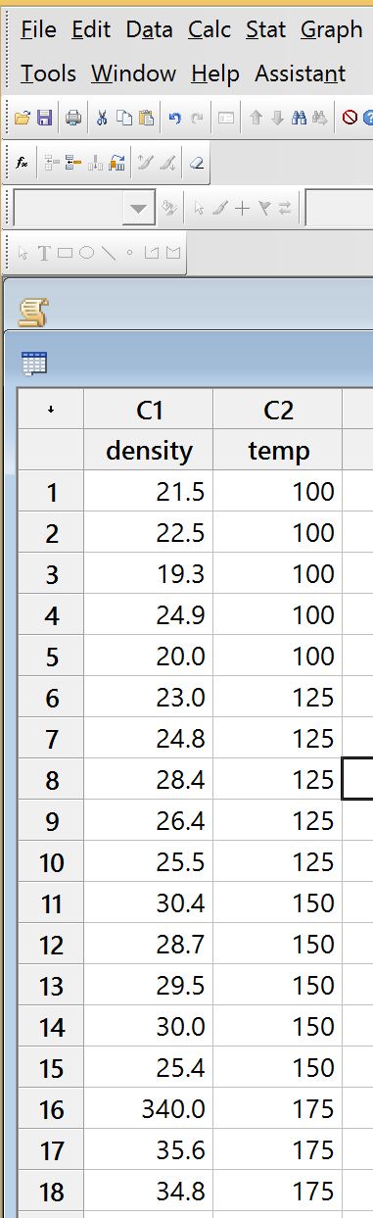
Concrete example
Enter data in Minitab worksheet
In order collected, if available
Do ANOVA
Check ANOVA residuals
Draw conclusions
Do Regression
Check Regression residuals
Draw conclusions

Slide 239
Concrete example
ANOVA Table from Minitab
General Linear Model: density versus temp
Factor Information
Factor Type Levels Values
temp Fixed 4 100, 125, 150, 175
Analysis of Variance
Source DF Adj SS Adj MS F-Value P-Value
temp 3 383.73 127.909 28.27 0.000
Error 16 72.40 4.525
Total 19 456.13
Does temperature affect concrete density?
H₀: μ₁₀₀=μ₁₂₅=μ₁₅₀=μ₁₇₅

Slide 240
Concrete example: ANOVA Residual Analysis

Slide 241
Concrete Example
Regression Analysis
Regression Analysis: density versus temp
Analysis of Variance
Source DF Adj SS Adj MS F-Value P-Value
Regression 1 381.421 381.421 91.90 0.000
temp 1 381.421 381.421 91.90 0.000
Error 18 74.705 4.150
Lack-of-Fit 2 2.305 1.152 0.25 0.778
Pure Error 16 72.400 4.525
Total 19 456.125
Model Summary
S R-sq R-sq(adj) R-sq(pred)
2.03722 83.62% 82.71% 79.48%
Coefficients
Term Coef SE Coef T-Value P-Value VIF
Constant 5.93 2.29 2.59 0.018
temp 0.1562 0.0163 9.59 0.000 1.00
Regression Equation
density = 5.93 + 0.1562 temp
Does temperature affect density? How?
H₀:β₁ = 0

Slide 242
Concrete example: Regression Residual Analysis

Slide 243
More NOTES
Residual analysis from designed experiment will NOT look the same as regression residual analysis
Why? Residuals will not have same values
Remember, in general:
For single factor ANOVA:
For simple linear regression:

Slide 244
Concrete Example
Predict density at temperature of 160.
Find 90% PI for density at temperature of 160.
Regression Equation
density = 5.93 + 0.1562 temp
Variable Setting
temp 160
Fit SE Fit 90% CI 90% PI
30.9304 0.584791 (29.9163, 31.9445) (27.2551, 34.6057)

Slide 245
Another Example
How does weight (in lbs) affect time (in sec) to run 100 yards?
Response = Y = ?
Factor = X = ?
Perform ANOVA to determine if weight affects run time?

Slide 246
ANOVA
General Linear Model: run time versus weight
Factor Information
Factor Type Levels Values
weight Fixed 9 112, 120, 126, 129, 132, 137, 139, 142, 148
Analysis of Variance
Source DF Adj SS Adj MS F-Value P-Value
weight 8 703.6 87.94 * *
Error 0 * *
Total 8 703.6
** Denominator of F-test is zero.

Slide 247
Plot data in Minitab
Graph
Scatterplot (simple)
Straight line good fit?

Slide 248
Find Regression Equation
By Hand or in Minitab
Regression Analysis: run time versus weight
Analysis of Variance
Source DF Adj SS Adj MS F-Value P-Value
Regression 1 663.20 663.199 115.03 0.000
weight 1 663.20 663.199 115.03 0.000
Error 7 40.36 5.765
Total 8 703.56
Model Summary
S R-sq R-sq(adj) R-sq(pred)
2.40110 94.26% 93.44% 89.21%
Coefficients
Term Coef SE Coef T-Value P-Value VIF
Constant -81.05 9.94 -8.15 0.000
weight 0.8071 0.0753 10.73 0.000 1.00
Regression Equation
run time = -81.05 + 0.8071 weight
Does weight affect run time?
If so, how?
H₀:β₁ = 0

Slide 249
Regression residual analysis

Slide 250
Predictions
Predict run time for weight of 135 lbs.
run time = -81.1 + 0.807*135 = 27.845 sec
Predict run time for weight of 95 lbs.
run time = -81.1 + 0.807*95 = - 4.44 sec

Slide 251
Predictions
Predictions only meaningful in general range of original data.
Be very careful extrapolating regression model
Y
X

Slide 252
Another Example
How does outdoor temperature affect time (in min) to unload truck?
Response = Y = ?
Factor = X = ?
Number of Replicates = ?
Perform ANOVA to determine if temp affects unload time?

Slide 253
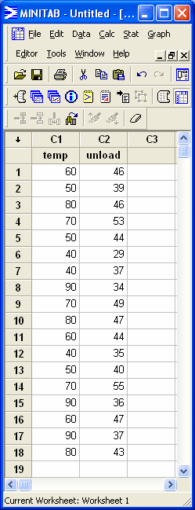
Truck Unload ANOVA
General Linear Model: unload versus temp
Factor Type Levels Values
temp fixed 6 40, 50, 60, 70, 80, 90
Analysis of Variance
Source DF Adj SS Adj MS F-Value P-Value
temp 5 724.28 144.856 20.37 0.000
Error 12 85.33 7.111
Total 17 809.61
Does outdoor temperature affect time (in min) to unload truck?
H₀: μ₄₀=μ₅₀=μ₆₀=μ₇₀=μ₈₀=μ₉₀

Slide 254
Truck Unload Example ANOVA Residual Analysis

Slide 255
Truck Unload Example
Regression Analysis: unload versus temp
Model Summary
S R-sq R-sq(adj) R-sq(pred)
6.94574 4.66% 0.00% 0.00%
Coefficients
Term Coef SE Coef T-Value P-Value VIF
Constant 36.77 6.44 5.71 0.000
temp 0.0848 0.0959 0.88 0.390 1.00
Regression Equation
unload time = 36.77 + 0.0848 temp
Does outdoor temperature affect time (in min) to unload truck?
Good regression model for this data? Why?

Slide 256
Truck Unload Example

Slide 257
Truck Unload Example
Plot data – straight line a good fit?

Slide 258
Truck Unload Example
Include higher order terms in model e.g. temp² term
Unload time = β₀ + β₁temp + β₂temp²
Now regression model has more than one term or regressor – called Multiple Linear Regression

Slide 259
Multiple Linear Regression
General multiple linear regression model with k regressors
Y = β₀ + β₁X₁ + β₂X₂ + … + β_{k}X_{k} + ε
For our truck unload example
X₁ = temp
X₂ = temp²
Model a linear function of parameters β₀, β₁, β₂, …, β_{k}
Testing for significance of regression now becomes:
H₀: β₁ = β₂ = … = β_{k} = 0
H₁: β_{k} ≠0 for at least one k

Slide 260
Multiple Linear Regression
Do not add too many terms to model
Adding terms will always make R² increase
If we had 8 data points, a model with 7 higher order terms will fit perfectly, i.e. R² = 100%
Y = β₀ + β₁X + β₂X² + β₃X³ + … + β₇X⁷
But too many terms will be difficult to interpret and will not give good predictions
So keep model as low order as possible

Slide 261
Multiple Linear Regression
For Multiple Linear Regression use Adjusted R² to measure model adequacy
Adjusted R² will not automatically increase as terms added to model.
R² adjusted by the number of terms in model
Where n = # data points and p = # terms in model (including constant)

Slide 262
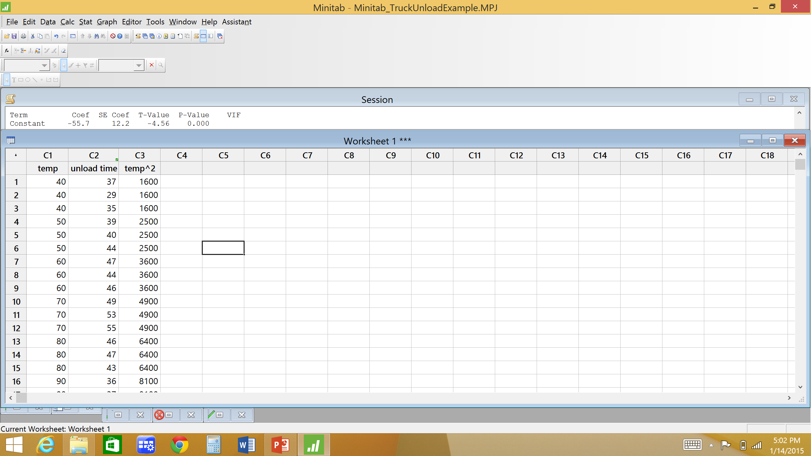
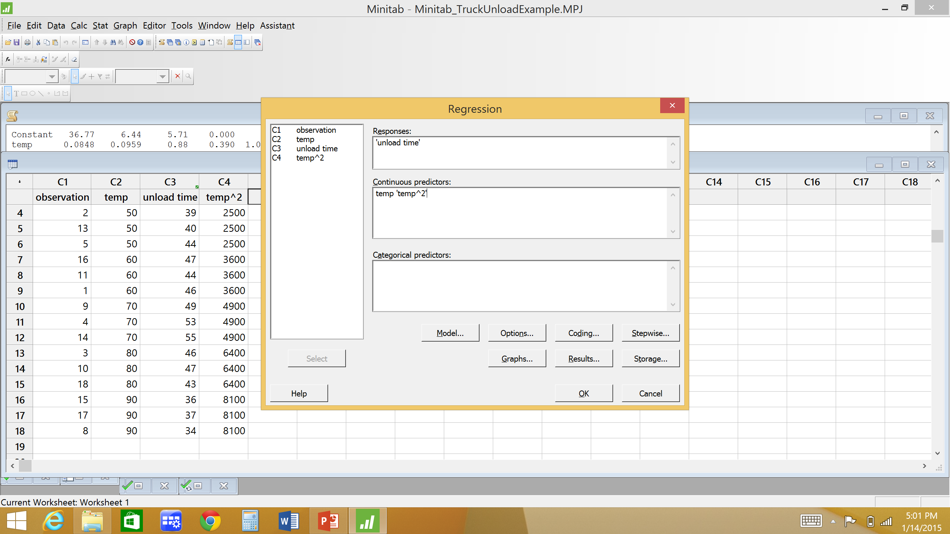
Truck Unload Example
Need to include temp² term in model
Still use Minitab Regression for multiple linear regression
Stat
Regression
Regression

Slide 263
Truck Unload Example
Regression Analysis: unload time versus temp, temp^2
Analysis of Variance
Source DF Adj SS Adj MS F-Value P-Value
Regression 2 656.87 328.433 32.25 0.000
temp 1 645.81 645.810 63.42 0.000
temp^2 1 619.15 619.147 60.80 0.000
Error 15 152.75 10.183
Lack-of-Fit 3 67.41 22.471 3.16 0.064
Pure Error 12 85.33 7.111
Total 17 809.61
Model Summary
S R-sq R-sq(adj) R-sq(pred)
3.19108 81.13% 78.62% 72.20%
Coefficients
Term Coef SE Coef T-Value P-Value VIF
Constant -55.7 12.2 -4.56 0.000
temp 3.141 0.394 7.96 0.000 80.22
temp^2 -0.02351 0.00302 -7.80 0.000 80.22
Regression Equation
unload time = -55.7 + 3.141 temp - 0.02351 temp^2
same

Slide 264
Truck Unload Example
Regression Analysis: unload time versus temp, temp^2
Analysis of Variance
Source DF Adj SS Adj MS F-Value P-Value
Regression 2 656.87 328.433 32.25 0.000
temp 1 645.81 645.810 63.42 0.000
temp^2 1 619.15 619.147 60.80 0.000
Error 15 152.75 10.183
Lack-of-Fit 3 67.41 22.471 3.16 0.064
Pure Error 12 85.33 7.111
Total 17 809.61
Model Summary
S R-sq R-sq(adj) R-sq(pred)
3.19108 81.13% 78.62% 72.20%
Summary for regression model (all terms) and error
If multiple replicates then error divided into 2 parts:
Lack-of-Fit: variation due to model inadequacy. If lack-of-fit significant then important terms may be missing from model or model does not explain several large residuals
Pure Error: random error estimate from multiple replicates

Slide 265
Minitab General Regression
Model Summary
S R-sq R-sq(adj) R-sq(pred)
3.19108 81.13% 78.62% 72.20%
R² (pred) is a measure of how well the model predicts the response.
R² (pred) indicates how well the model predicts responses for new observations. Larger values of R² (pred) suggest models of greater predictive ability. Calculated using the PRESS Statistic.
PRESS is the sum of squares of the prediction error. In general, the smaller the PRESS value, the better the model's predictive ability. PRESS is used to calculate the predicted R.

Slide 266
Truck Unload Example
Regression Analysis: unload time versus temp, temp^2
Analysis of Variance
Source DF Adj SS Adj MS F-Value P-Value
Regression 2 656.87 328.433 32.25 0.000
temp 1 645.81 645.810 63.42 0.000
temp^2 1 619.15 619.147 60.80 0.000
Error 15 152.75 10.183
Lack-of-Fit 3 67.41 22.471 3.16 0.064
Pure Error 12 85.33 7.111
Total 17 809.61
Model Summary
S R-sq R-sq(adj) R-sq(pred)
3.19108 81.13% 78.62% 72.20%
Coefficients
Term Coef SE Coef T-Value P-Value VIF
Constant -55.7 12.2 -4.56 0.000
temp 3.141 0.394 7.96 0.000 80.22
temp^2 -0.02351 0.00302 -7.80 0.000 80.22
Regression Equation
unload time = -55.7 + 3.141 temp - 0.02351 temp^2
Model a good fit to data?
Does temperature affect truck unload time?
H₀:β₁=0
H₀:β₂=0

Slide 267
Truck Unload Example Regression Residual Analysis

Slide 268
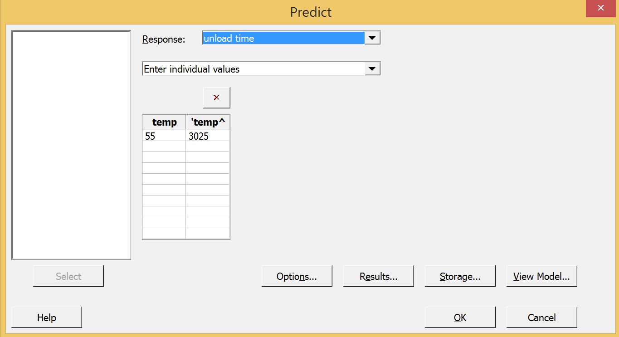
Truck Unload Example
Predict unload time for temperature of 55
Unload time = -55.7 + 3.14(55) – 0.0235(55²) = 45.94 min
95% PI on unload time for temperature of 55
In Minitab, ‘Prediction’ menu of General Regression Menu

Slide 269
Truck Unload Example
Regression Equation
unload time = -55.7 + 3.141 temp - 0.02351 temp^2
Variable Setting
temp 55
temp^2 3025
Fit SE Fit 95% CI 95% PI
45.9366 1.04580 (43.7075, 48.1657) (38.7790, 53.0942)

Slide 270
Regression Analysis
What to do when R² value not as large as you’d like?
Look at regression residual analysis
If residual plots look bad
Try transforming response variable
Try including higher order term(s) in model
If residual plots look good
Indication there are 1 or more significant factors not included in this data
Rethink experiment

Slide 271
Choice of Sample Size
A part of any experimental design is to choose sample size
How many replicates to collect at each factor level?
Depends on how large a difference in response means at two factor levels the experimenter defines as statistically different (or the same)?
Cake baking experiment: if one factor level (# eggs) had a mean cake height of 2” and another factor level had a mean cake height of 3”, is that a significant difference?
What about 2” vs 2.2”?
In general more replicates needed to detect small effects (i.e. small difference in factor level means); fewer replicates needed to detect large difference in factor level means

Slide 272
Choice of Sample Size
Blood Coagulation example: conduct an experiment to investigate if diet affects the blood coagulation time (in minutes) of a chemical reaction.
Response: blood coagulation time (min)
Factor: diet
# Factor Levels: 4
We want to be able to detect a difference in the blood coagulation time population means of 5 minutes between any two diets.
We want to reject H₀ = μ_{A} =μ_{B}=μ_{C}=μ_{D} with probability 90% if the difference in any two factor level means is at least 5 minutes.
D = max difference = 5
Power = 1-β = .90

Slide 273
Choice of Sample Size
What is Power?
Remember: There are four possible outcomes for a hypothesis test. The outcomes depend on whether the null hypothesis (H₀) is true or false and whether you decide to "reject" or “accept" H₀.
When H₀ is true and you reject it, you make a Type I error. The probability of making a Type I error is called alpha (α) and is sometimes referred to as the level of significance for the test.
When H₀ is false and you fail to reject it, you make a type II error. The probability of making a type II error is called beta (β).
 | H₀ true | H₀ False
Accept H₀ | Correct decision p=1-α | Type II error p=β
Reject H₀ | Type I error p=α | Correct decision p=1-β
Power

Slide 274
Choice of Sample Size
The power of a test is the probability of correctly rejecting H₀ when it is false. In other words, power is the likelihood that you will identify a significant difference (effect) when one exists.
Ideally, you want to have high power to detect a difference that you care about, and low power for a meaningless difference.
Factors that influence power
α, the probability of a Type I error (level of significance). As the probability of a Type I error (α) increases, the probability of a type II error (β) decreases. Hence, as α increases, power = 1 - β also increases.
σ², the variability in the population. As σ increases, power decreases.
D, the size of the population difference (effect). As the size of population difference (effect) decreases, power decreases.
sample size. As sample size increases, power increases.

Slide 275
Choice of Sample Size
Perform choice of sample size in Minitab
For the blood coagulation example
n = # levels = 4
D = max difference = 5
1-β = power = 0.90
We also need values for σ and α
σ can be found from ANOVA MS_{E} for pre-experiment or historical data → σ ≈ √MS_{E}
Remember from ANOVA, MS_{E} = 5.6 → use σ = √5.6 = 2.36643
Use α = 0.05

Slide 276
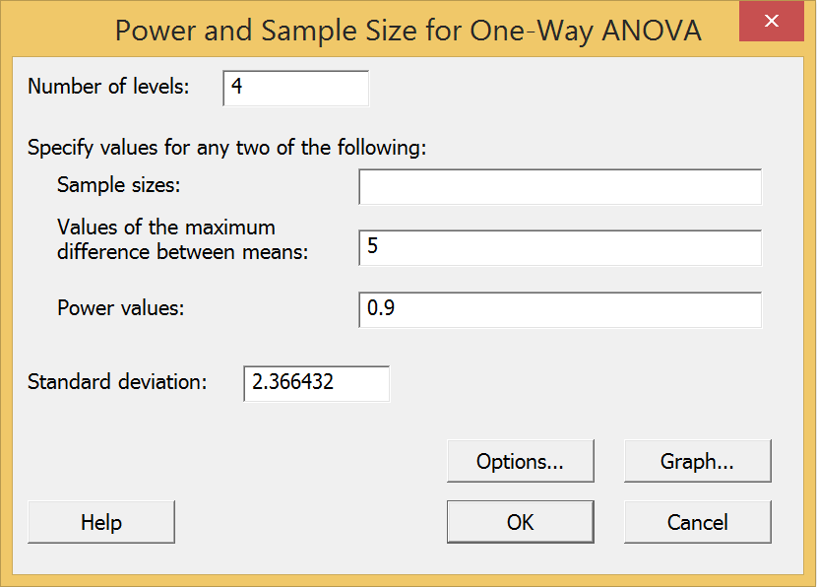
Choice of Sample Size
In Minitab
Stat
Power and Sample Size
One-way ANOVA
St. Dev. = √MS_{E} from pre-experiment

Slide 277
Choice of Sample Size
Power and Sample Size
One-way ANOVA
α = 0.05 Assumed standard deviation = 2.36643
Factors: 1 Number of levels: 4
Maximum Sample Target
Difference Size Power Actual Power
5 8 0.9 0.925940
The sample size is for each level.
n=8 at each factor level
N = 4*8 = 32

Slide 278
Choice of Sample Size
Now what if we want to detect a difference in factor level means of 3.5 minutes?
Now D = 3.5 minutes
Will sample size be larger or smaller than when D = 5?
Power and Sample Size
One-way ANOVA
α = 0.05 Assumed standard deviation = 2.36643
Factors: 1 Number of levels: 4
Maximum Sample Target
Difference Size Power Actual Power
3.5 14 0.9 0.900555
The sample size is for each level.
n=14 at each factor level
N = 4*14 = 56

Slide 279
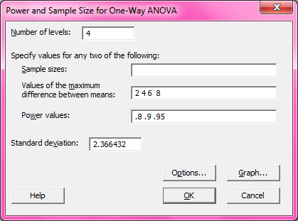
Choice of Sample Size
Minitab can give sample sizes for several scenarios at once
Enter several detectable differences and/or power values
Minitab will show sample size for each

Slide 280
Choice of Sample Size
Power and Sample Size
One-way ANOVA
Alpha = 0.05 Assumed standard deviation = 2.36643
Factors: 1 Number of levels: 4
Maximum Sample Target
Difference Size Power Actual Power
2 32 0.80 0.806766
2 41 0.90 0.902582
2 50 0.95 0.953849
4 9 0.80 0.818083
4 11 0.90 0.901491
4 14 0.95 0.964099
6 5 0.80 0.857319
6 6 0.90 0.930830
6 7 0.95 0.968285
8 4 0.80 0.938456
8 4 0.90 0.938456
8 5 0.95 0.985536
The sample size is for each level.

Slide 281
Nonparametric Test
ANOVA is a parametric test – based on underlying assumption of normality
What if normality assumption not valid?
Normal probability plot of residuals really not a straight line
Must use nonparametric test – no assumptions of underlying distributions
Kruskal Wallis – nonparametric equivalent of ANOVA

Slide 282
Nonparametric Test
Advantages
Fewer assumptions – valid under weaker assumptions
Can be used for very small sample sizes
Can be used for categorical data
Disadvantages
If distributional assumptions of parametric test are valid, then the parametric test will give a more precise and powerful analysis than nonparametric test

Slide 283
Kruskal-Wallis Test
Kruskal-Wallis is a test for equality of factor level means; therefore a nonparametric alternative to ANOVA
Kruskal-Wallis is an analysis of variance of ranks
Each of the N observations replaced by its rank
Compute average rank for each factor level
Compare average ranks of the factor levels; if no difference among factor levels then all the average ranks should be approximately equal

Slide 284
Kruskal-Wallis Test
Rank the observations,Y_{ij}, in ascending order
Replace each observation by its rank, R_{ij}, with the smallest observation having rank 1. In the case of ties (i.e. observations with the same value) assign the average rank to each of the tied observations.
Calculate the test statistic, H
where
n_{i} = number of observations in the i^{th} factor level
N = total number of observations
S² = variance of the ranks (see formula on next slide)

Slide 285
Kruskal-Wallis Test
If the n_{i} are reasonably large, (n_{i} ≥ 5 ), then H is distributed approximately as χ²_{α,a-1}.
Therefore, if H > χ²_{α,a-1} the null hypothesis (i.e. all a factor levels produce the same response) is rejected.

Slide 286
Circuit Noise Example
Example: Does design affect circuit noise?
Response? Factor? # Factor Levels? # Replicates?

Slide 287
Circuit Noise Example
First try ANOVA
General Linear Model: noise versus design
Factor Information
Factor Type Levels Values
design Fixed 3 1, 2, 3
Analysis of Variance
Source DF Adj SS Adj MS F-Value P-Value
design 2 211.5 105.74 4.77 0.015
Error 32 709.5 22.17
Total 34 921.0
Does design affect circuit noise?
H₀: μ₁=μ₂=μ₃

Slide 288
Circuit Noise Example

Slide 289
Circuit Noise Example
Try Box-Cox transformation in Minitab
Regression Analysis: noise versus design
Method
Rows unused 7
Box-Cox transformation
Rounded λ 0
Estimated λ 0.0409679
95% CI for λ (-0.893532, 0.963468)
Regression Equation
ln(noise) = 2.29631 + 0.178536 design
ln(noise) = BOXC1
e.g. ln(10.4) = 2.34181

Slide 290
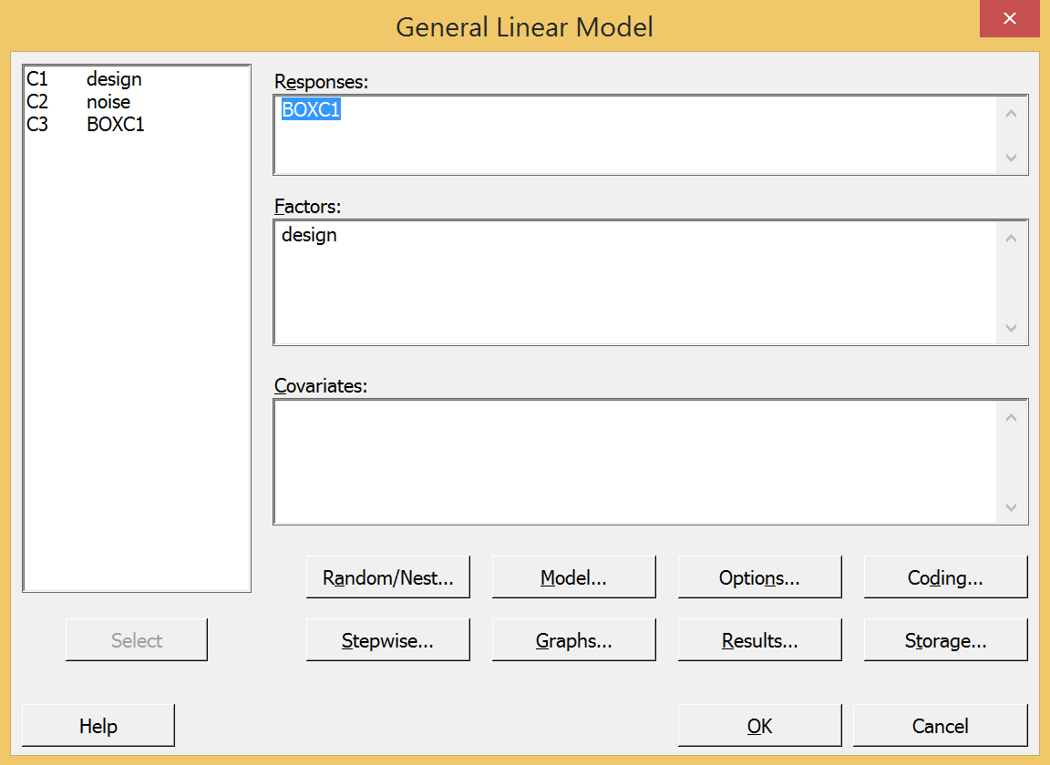
Circuit Noise Example
Box-Cox transformation in Minitab
Transform response in >Regression > Regression
Then use transformed response in ANOVA
Normal distribution assumption violated – use nonparametric test, Kruskal-Wallis

Slide 291
Circuit Noise Example
ANOVA residuals do not look good. Normality assumption appears to be violated
Use nonparametric test (Kruskal Wallis) to compare differences in circuit noise among designs

Slide 292
Circuit Noise Example
Rank the observations,Y_{ij}, in ascending order
Replace each observation by its rank, R_{ij}

Slide 293
Circuit Noise Example
R _{1•} = 6+7+8+9+10.5+12+13.5+13.5+15+16+17 = 127.5
R _{2•} = 1+2.5+4+18+19+20+21+22+23.5+23.5+26+31+33+34 = 278.5
R _{3•} = 2.5+5+10.5+25+27+28+29+30+32+35 = 224
R _{1•} = 11.59
R _{2•} = 19.89
R _{3•} = 22.40

Slide 294
Circuit Noise Example
For α=0.05
Since 6.629>5.99 we reject H₀
We conclude design does affect circuit noise
Table III value

Slide 295
Circuit Noise Example
In Minitab
Stat
Nonparametrics
Kruskal-Wallis
Enter actual responses, not ranks

Slide 296
Circuit Noise Example
Kruskal-Wallis Test: noise versus design
Kruskal-Wallis Test on noise
design N Median Ave Rank Z
1 11 11.50 11.6 -2.51
2 14 16.25 19.9 0.89
3 10 18.10 22.4 1.61
Overall 35 18.0
H = 6.62 DF = 2 P = 0.036
H = 6.63 DF = 2 P = 0.036 (adjusted for ties)
Does design affect circuit noise?

Slide 297
HW#3 here
Due date =
Unless otherwise stated, you may use Minitab to do HW assignments
If submitting HW electronically, submit one (1) file only !!!
Can copy Minitab output and paste into MS Word. Use ‘Courier New’ font when pasting Minitab output in MS Word.
Indicate where the answer is located in Minitab output (circle, highlight, etc.)
Data sets can be copied from assignment document and pasted into Excel or Minitab. Some data sets may need to be rearranged before conducting an analysis in Minitab

Slide 298
Test #1
Test #1 date:
Closed Book
1 page (8.5”x11”) notes. You may write on both sides of the page
Bring a calculator
All relevant statistical tables will be provided
Z, t, F, χ², q (tukey test)
No sharing of materials during test
No laptops
No statistical software

Slide 299
Topics on Test #1
Covers Chpt.s 1-3; HWs #1, 2, & 3
Simple comparative experiments
Single Factor ANOVA
Pairwise comparisons
CI
Tukey
Regression Analysis
Simple Linear
Multiple Linear
Residual Analysis
ANOVA
Regression
Choice of Sample Size
Nonparametric test (Kruskal-Wallis test)
p-value

